Slide 1
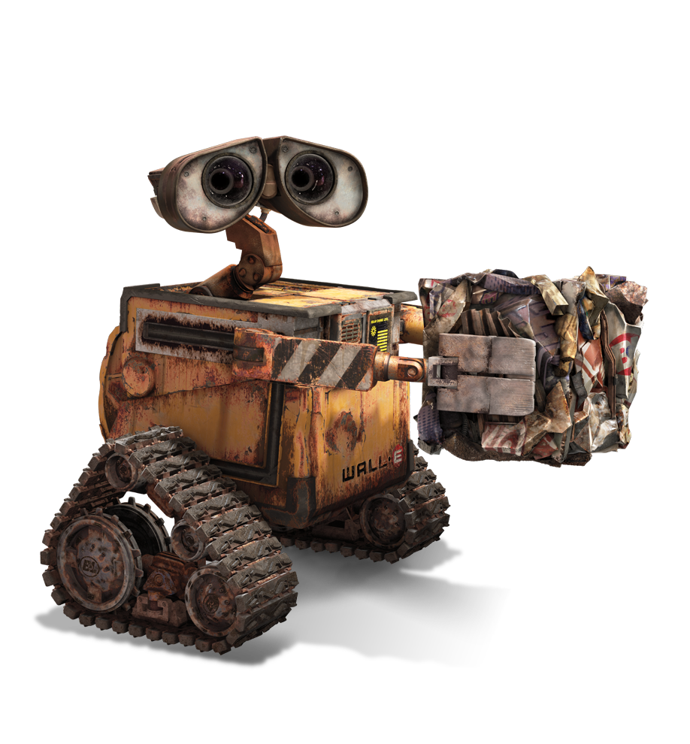
Практический ИИ: какие задачи реально решать с помощью технологий искусственного интеллекта
Артем Чернодуб
Clikque Technology
iForum’2017, 25 мая 2017, г. Киев

Slide 2



Ukrainian successful AI-related companies
Viewdle (acquired by Google for $20-40M in 2012).
Looksery (acquired by Snapchat for $150M in 2015).
Grammarly (received more than $100M investments in 2017).
2 / 42

Slide 3
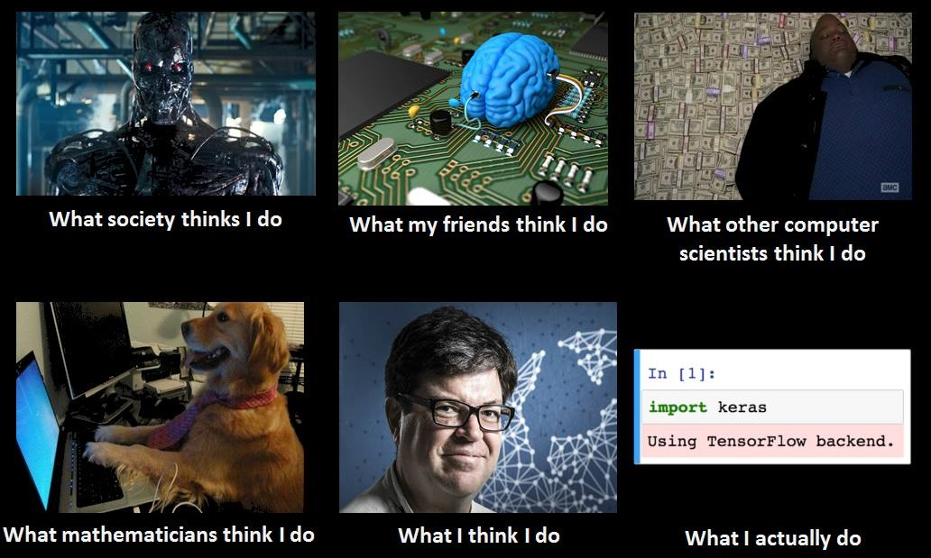
Artificial Intelligence
3 / 42

Slide 4

Classic and AI programming
Problem
Analytical solution
Data
(labeled)
Training
algorithm
Problem
Empirical solution
4 / 42

Slide 5

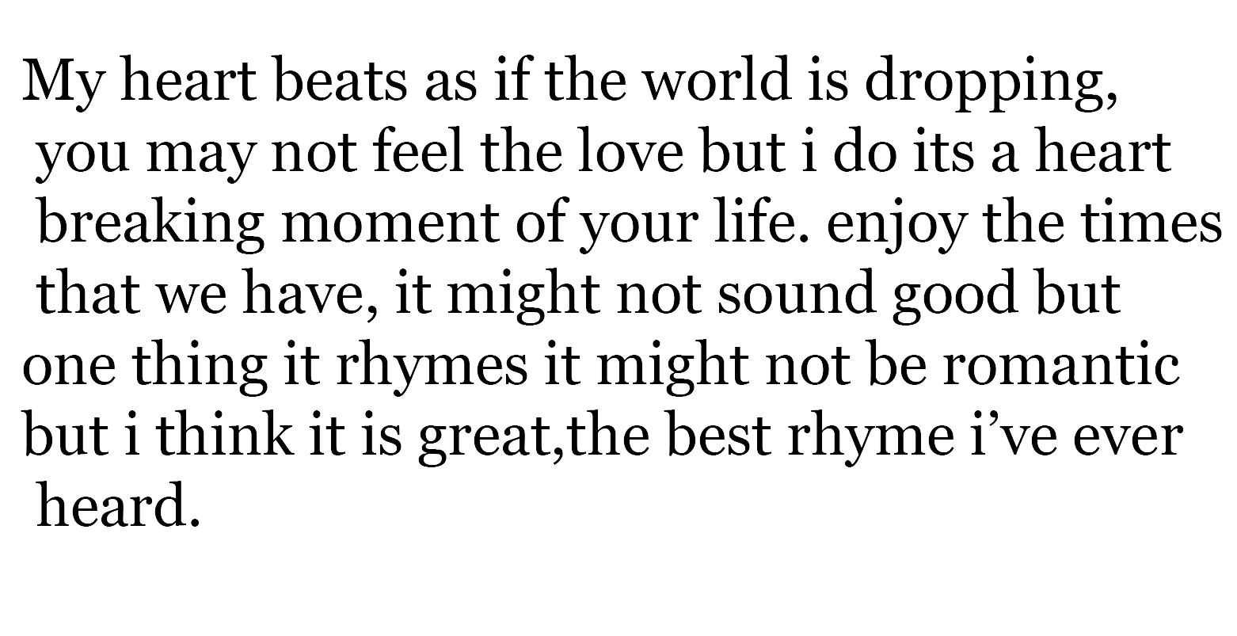
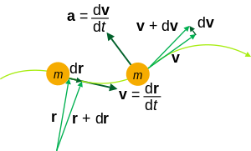
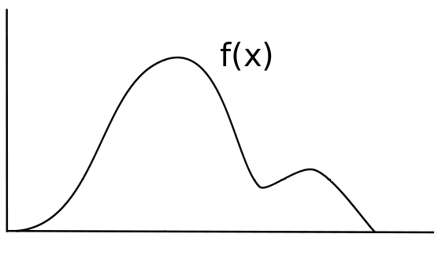
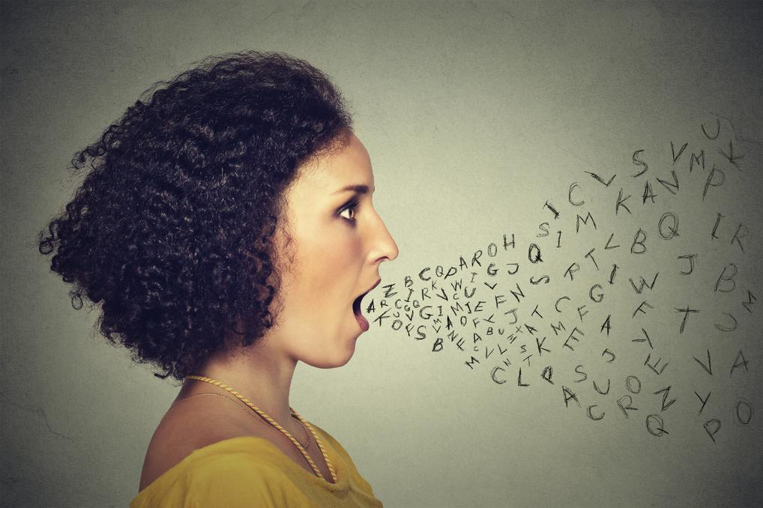
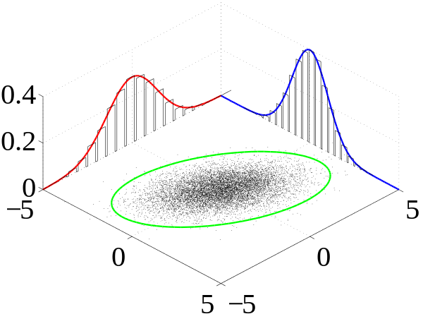
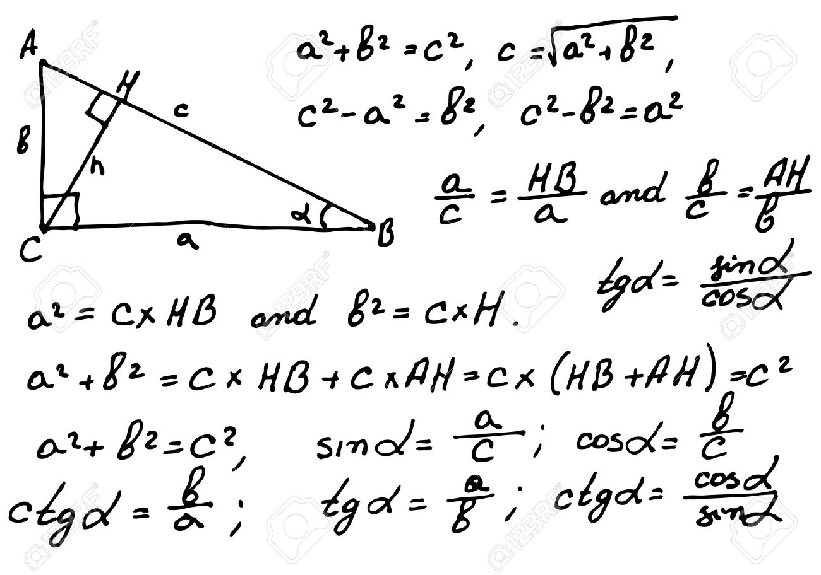
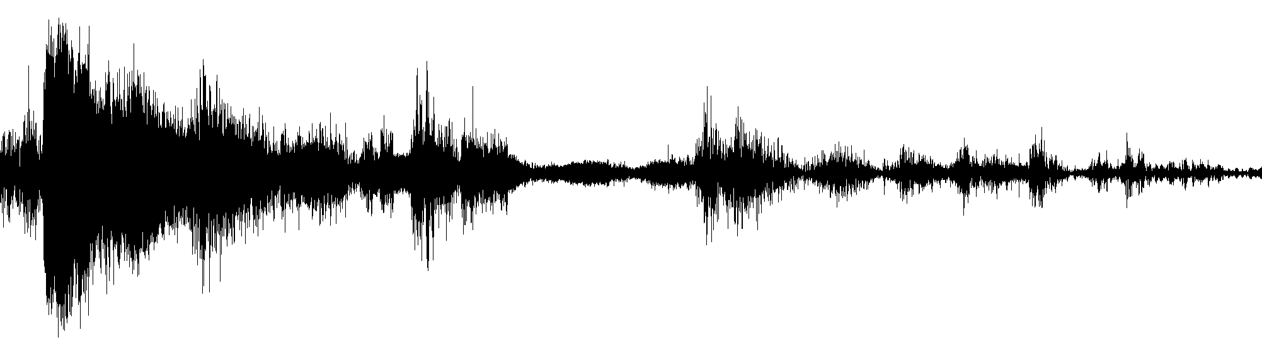
Classic programming
Things...
Our Knowledge...
Images copyright © Stanford CS331b, 2016
5 / 42

Slide 6


AI programming (Machine Learning)
~6 kg
X
X
X
X
X
X
X
X
X
X
X
X
X
X
X
X
X
X
X
X
X
X
X
X
X
X
w
-5
0
7
11
15
+20
~4 kg
Type A
Representation
Mathematical Model (Classifier)
Weight (w)
w>5
Type B
Images copyright © Stanford CS331b, 2016
6 / 42

Slide 7
Hardware costs
Date | Approximate cost per GFLOPS inflation adjusted to 2013 US dollars | Platform providing the lowest cost per GFLOPS
1984 | $42,780,000 | Cray X-MP/48
1997 | $42,000 | Two 16-processor Beowulf clusters with Pentium Pro
August 2007 | $52 | Microwulf (Personal, Portable Beowulf Cluster)
November 2013 | $0.16 | AMD Sempron 145 & GeForce GTX 760 System
January 2015 | $0.08 | Celeron G1830 & Radeon R9 295X2 System
Source: https://en.wikipedia.org/wiki/FLOPS
7 / 42

Slide 8
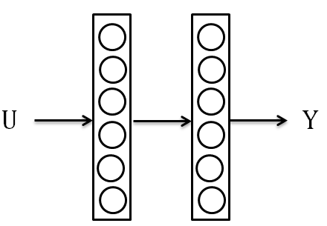
Shallow Neural Networks
42
Single hidden layer (Kolmogorov-Cybenko Universal Approximation Theorem as the main hope).
Vanishing gradients effect prevents using more layers.
Less than 10K free parameters.
Feature preprocessing stage is often critical.
8 / 42

Slide 9
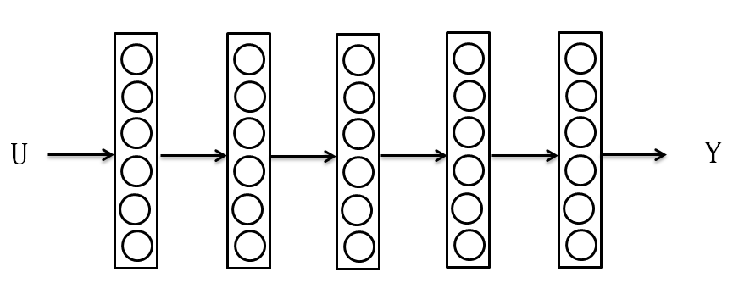
Deep Feedforward Neural Networks
2-stage training process: i) unsupervised pre-training; ii) fine tuning (vanishing gradients problem is beaten!).
Hidden layers > 1: e.g. 2012 – 6, 2014 – 18, 2015 - 156.
No (or less) feature preprocessing stage.
100K – 100M free parameters.
9 / 42

Slide 10
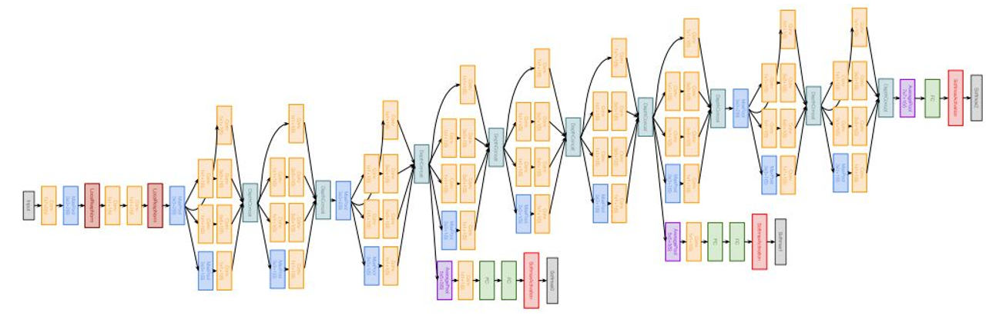
Example of Deep Neural Network: GoogleNet (2014)
10 / 42

Slide 11
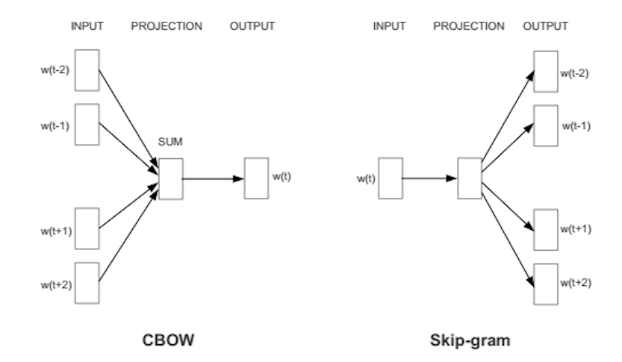
Example of representation learning for texts: word2vec
11 / 42

Slide 12
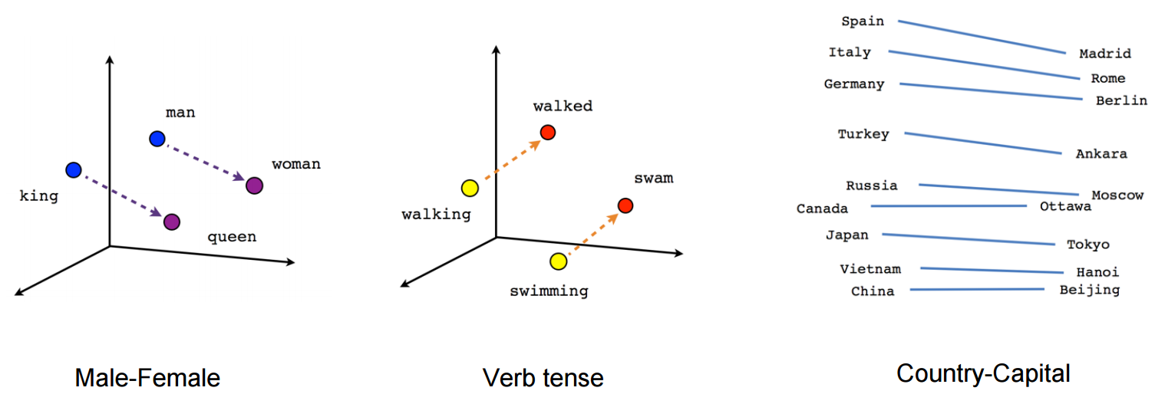
word2vec: empirically found relationships between words
12 / 42

Slide 13
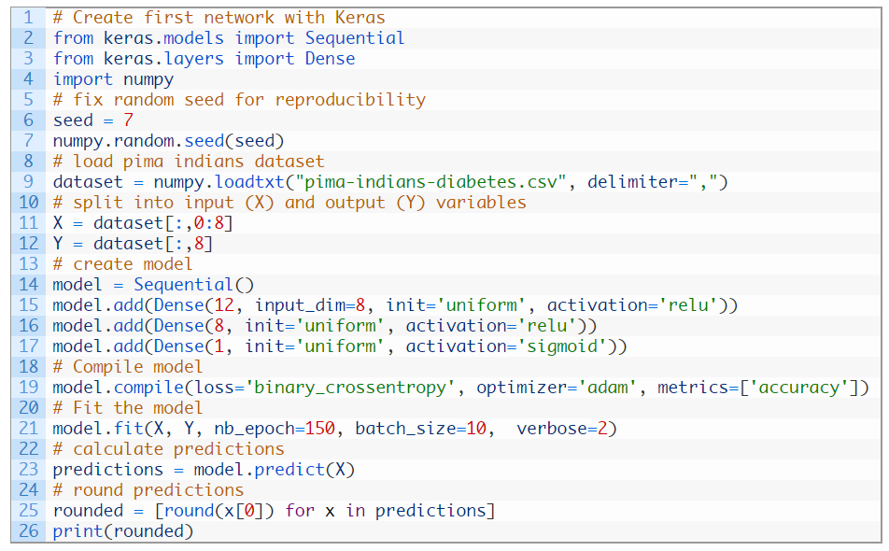
Example of Neural Network designed in Keras
13 / 42

Slide 14
Common ML Problems
Supervised Learning
1a. Classification
1b. Regression
2. Unsupervised Learning
2a. Clustering
2b. High Dimension Visualization
2c. Generative Models
14 / 42

Slide 15
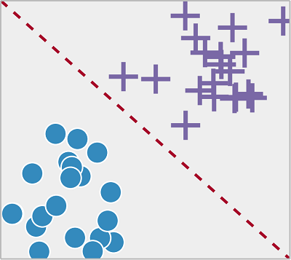
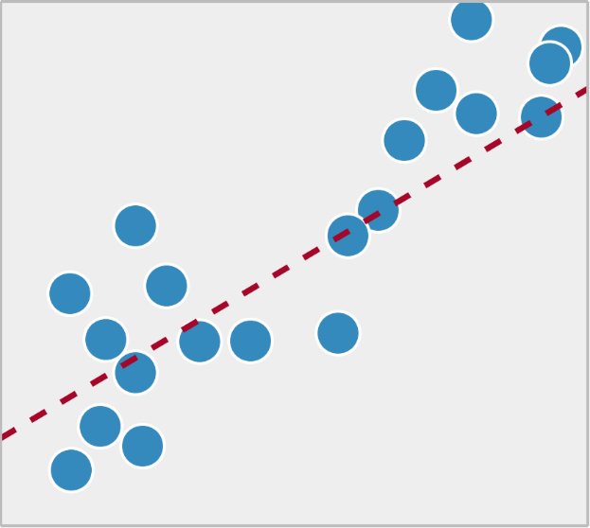
1. Common ML: Supervised Learning
1a. Classification
1b. Regression
15 / 42

Slide 16
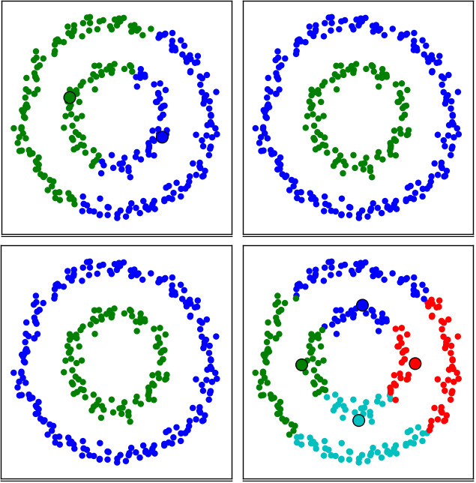
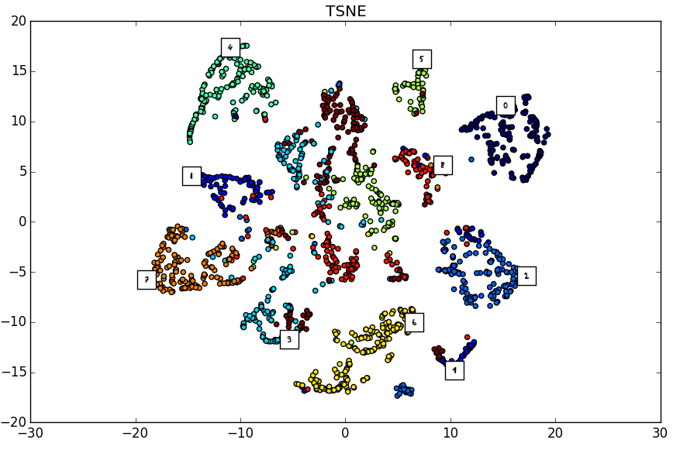
2. Common ML: Unsupervised Learning
2a. Clustering
2b. High Dimension Visualization
16 / 42

Slide 17
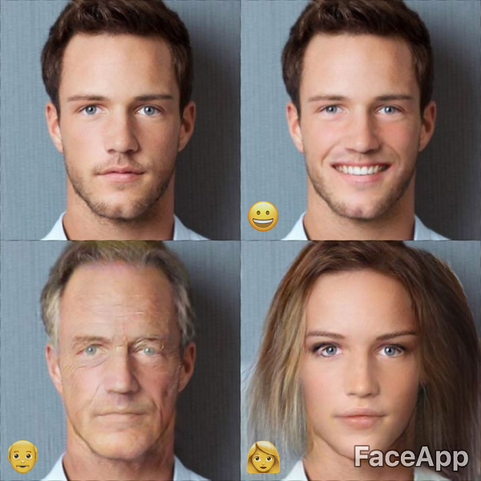
2c. Generative Models
Capture the probability distribution of your input data to generate more data
17 / 42

Slide 18
Examples of AI problems by domains
A. Computer Vision (CV)
A1. Image classification.
A2. Face/object detection/recognition
A3. Image retrieval
A4. OCR
A5. Unmanned cars CV problems
A6. Aerial/Satellite Photo Recognition
B. Natural Language Processing (NLP)
B1. Sentiment Analysis
B2. Relationship extraction
B3. Named Entity Recognition
B4. Machine Translation
B5. Question Answering (chatbots)
B6. Language identification
C. Audio processing
C1. Speech recognition
C2. Music/genre recognition
D. Financial forecasting
D1. Projection/forecasting of time series
D2. Trends decomposition
E. Recommender systems
E1. Collaborative filtering
E2. Content-based filtering
E3. Hybrid filtering
18 / 42

Slide 19
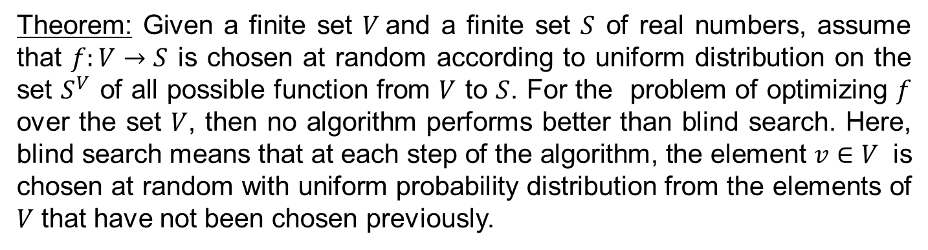
No free lunch theorem (Wolpert, 1996)
Theorem: Given a finite set $V$and a finite set $S$ of real numbers, assume that $f:V→S$ is chosen at random according to uniform distribution on the set $S^{V}$ of all possible function from $V$ to $S$. For the problem of optimizing $f$ over the set $V$, then no algorithm performs better than blind search. Here, blind search means that at each step of the algorithm, the element $v∈V$ is chosen at random with uniform probability distribution from the elements of $V$ that have not been chosen previously.
Interpretation:
No machine learning algorithm is universally better than any other.
We must design our machine learning algorithms to perform well on a specific task.
Source: https://en.wikipedia.org/wiki/No_free_lunch_theorem
19 / 42

Slide 20
Building AI scenarios
Building AI from scratch
Building AI using ML libraries
Building AI using SaaS model
20 / 42

Slide 21
Ready-to-use AI services (SaaS)
Microsoft Cognitive Services: wide spectrum of AI-related services, image, text & voice recognition. Image categorization, face recognition, speech recognition, text analytics, etc. $1.5 - $0.25 per 1000 transactions.
Amazon AI services: image and facial analysis (Amazon Rekognition), text-to-speech (Amazon Polly), building conversational chatbots with automatic speech recognition and natural language understanding (NLU) capabilities (Amazon Lex).
IBM Watson: Translate content into multiple languages (Language Translator), Interpret and classify natural language with confidence (Natural Language Classifier), understand personality characteristics, needs, and values in written text (Personality Insights), Understand tone and style in written text (Tone Analyzer).
21 / 42

Slide 22
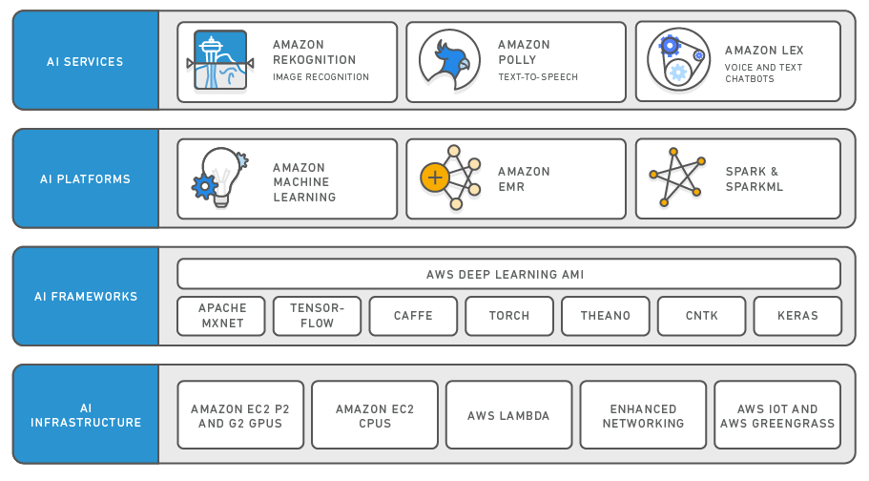
Amazon services
22 / 42

Slide 23
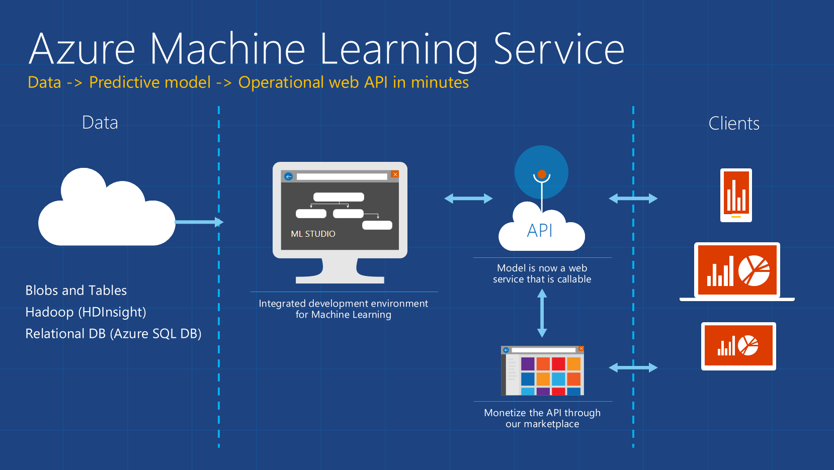
Microsoft services
23 / 42

Slide 24
Tools and frameworks
Neural networks/common libs:
MATLAB (Neural Networks Toolbox, Image Processing Toolbox, etc.)
TensorFlow (Google)
Caffe (Berkeley)
Keras (Intel)
Theano
Torch, PyTorch (Facebook)
CNTK (Microsoft)
sci-kit learn
Pylearn
libSVM/libLinear
Spark with MLLib
Computer Vision:
OpenCV – general purposes
CCV – general purposes
VLFeat – general purposes
Dlib C++ Library – facial recognition
Natural Language Processing:
Natural Language Toolkit (NLTK) – general purposes
Stanford NLP Software – CoreNLP, Parser, PosTagger, Named Entity Recognizer, Relation Extractor.
fastText – text categorization
ParlAI – dialog systems, chatbots, and question-answering systems
GenSim – topic modelling and similarity detection
24 / 42

Slide 25
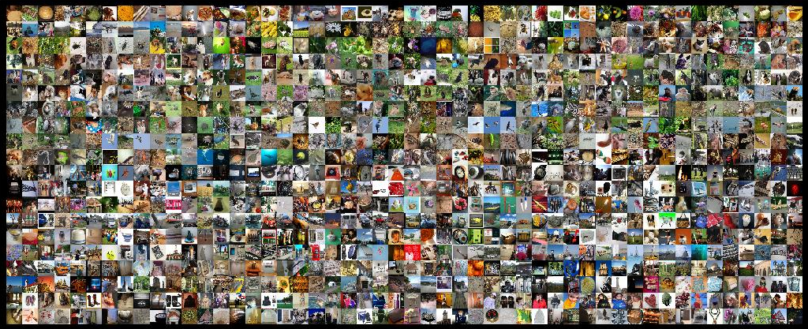
A1. Image classification. Example: ILSVRC, ResNet (Microsoft, 2015)
Model | Size | Top 5 error, %
ResNet | 230 Mb | 3.6
Human level | N/A | 5.1
He, Kaiming, et al. "Deep residual learning for image recognition“ // Proceedings of the IEEE Conference on Computer Vision and Pattern Recognition, 2016.
Libs: Caffe (Model Zoo), Tensorflow, Keras, etc.
API: Amazon AI (Rekognition), Microsoft Cognitive Services.
25 / 42

Slide 26
A1. Image classification. Model Zoo: pre-trained Neural Networks models
Sentiment Analysis
General images
Scene Recognition using Places Database
Oxford flowers
Age and Gender Classification
Car model classification
Edge Detection
VGG Face CNN descriptor
Emotion Recognition
Facial Landmark Detection
Microscopy images of yeast cells carrying fluorescent proteins
Biomedical Image Segmentation
Semantic segmentation on aerial images
Etc.
https://github.com/BVLC/caffe/wiki/Model-Zoo
26 / 42

Slide 27
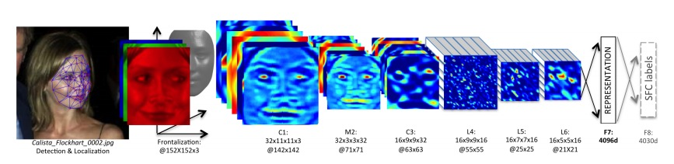
A2. Face Recognition: Deep Face (Facebook, 2014)
Model | # of parameters | Accuracy, %
Deep Face Net | 128M | 97.35
Human level | N/A | 97.5
Y. Taigman, M. Yang, M.A. Ranzato, L. Wolf. DeepFace: Closing the Gap to Human-Level Performance in Face Verification // CVPR 2014.
Libs: OpenCV, Dlib, Caffe.
27 / 42

Slide 28
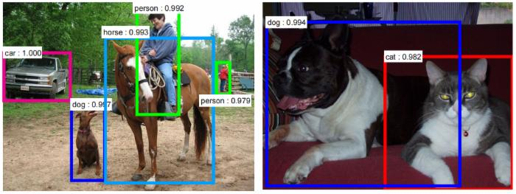
A2. Object Detection/Localization
Libs: Open CV (Viola-Jones), Fast R-CNN, YOLO, Faster R-CNN.
28 / 42

Slide 29
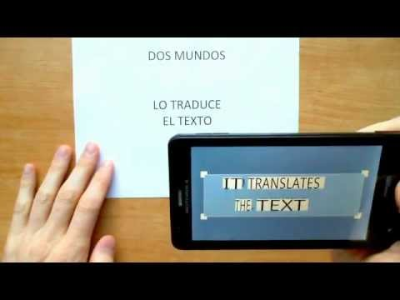
A4 + B4. OCR + Translation
Libs: TensorFlow, TensorFlow Lite, OpenCV.
29 / 42

Slide 30
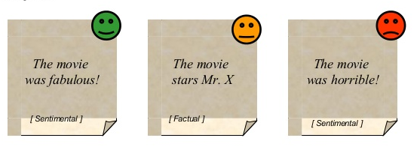
B1. Sentiment Analysis
Identify opinion of the text (blogs, user comments, review, etc.
Libs: NLTK, RapidMiner, GATE.
30 / 42

Slide 31
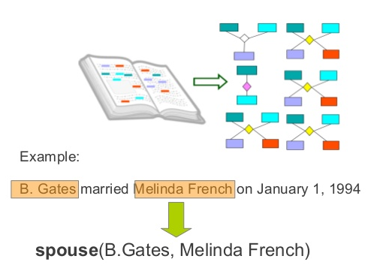
B2. Relationship extraction
From natural language text detect sematic relationships between entities.
Libs: NLTK, PATTY, Reverb, Examplar.
31 / 42

Slide 32
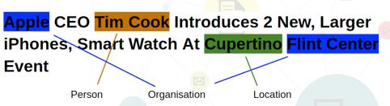
B3. Named Entity Recognition
Locate and classify named entities in text into pre-defined categories such as the names of persons, organizations, locations, expressions of times, quantities, monetary values, percentages, etc.
Libs: Stanford Named Entity Recognizer, MITTIE, OpeNER.
32 / 42

Slide 33
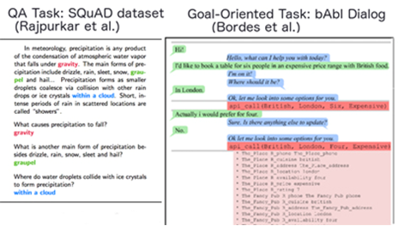
B5. Questions Answering (chatbots)
Libs: ParlAI, chatbot-retrieval, BIOASQ suite, TensorFlow, NLTK, etc.
33 / 42

Slide 34

C1. Speech Recognition
Libs: CMU Sphinx - Speech Recognition Toolkit, Kaldi.
API: Google Speech API, Microsoft Cognitive Services - Bing Speech API, API.AI.
34 / 42

Slide 35
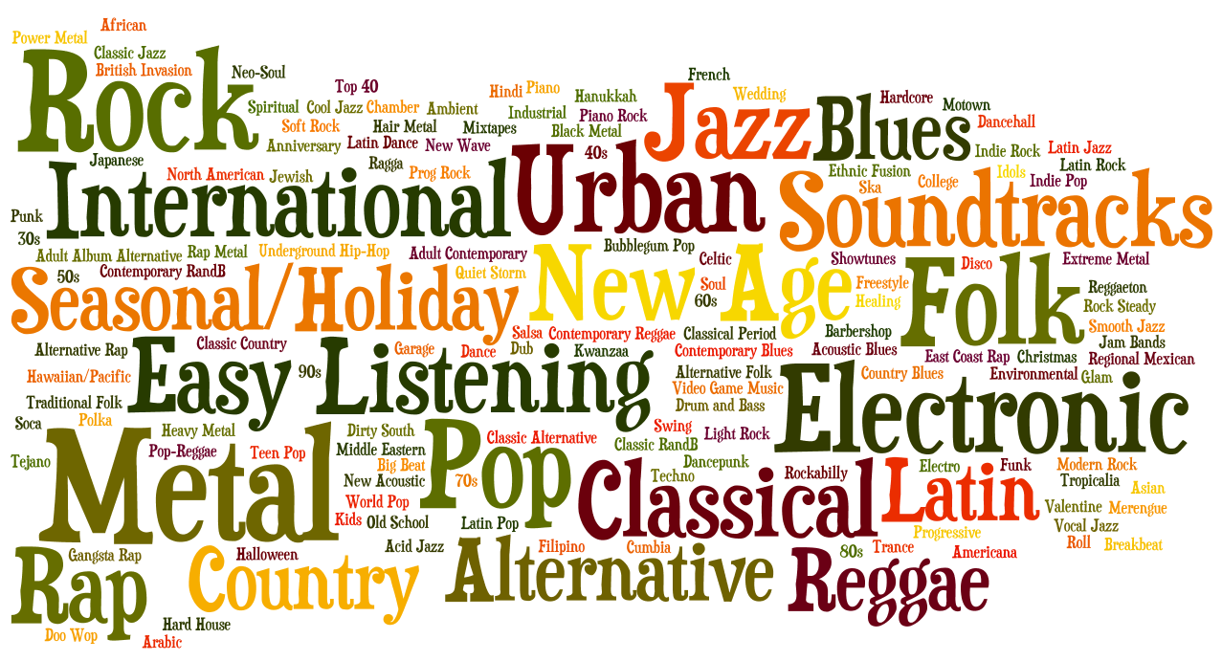
C2. Music/Genre recognition
Libs: genreXpose, genre-classification.
APIs: The Echo Nest, niland.io.
35 / 42

Slide 36
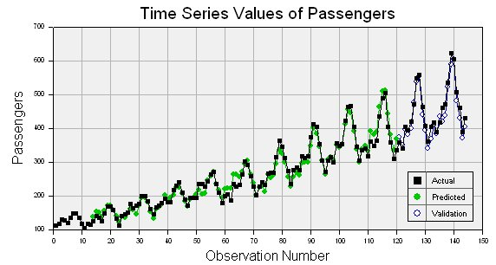
D1. Time series forecasting
Libs: SPSS, SAS, R, MATLAB, Excel.
36 / 42

Slide 37
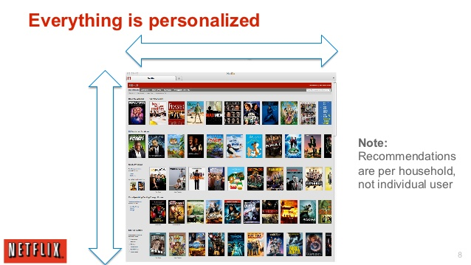
E. Recommender systems
Libs: PredictionIO, Raccoon Recommendation Engine, HapiGER, EasyRec.
API: Google Cloud Prediction API, Azure ML, SuggestGrid, Mortar Recommendation.
37 / 42

Slide 38
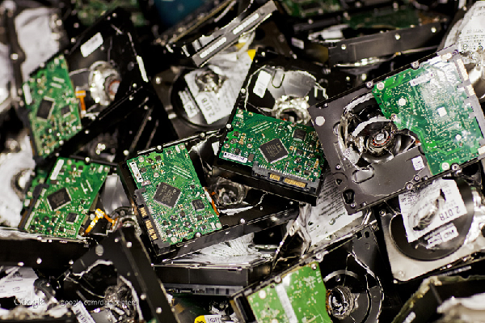
Conclusion: all you need is data!
38 / 42

Slide 39
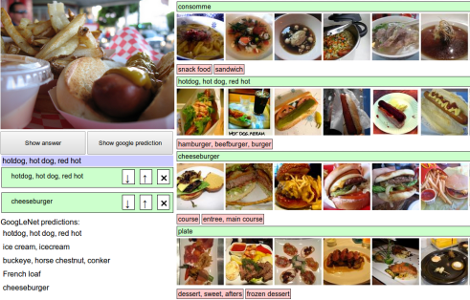
Example of data labeling interface
39 / 40
39 / 42

Slide 40
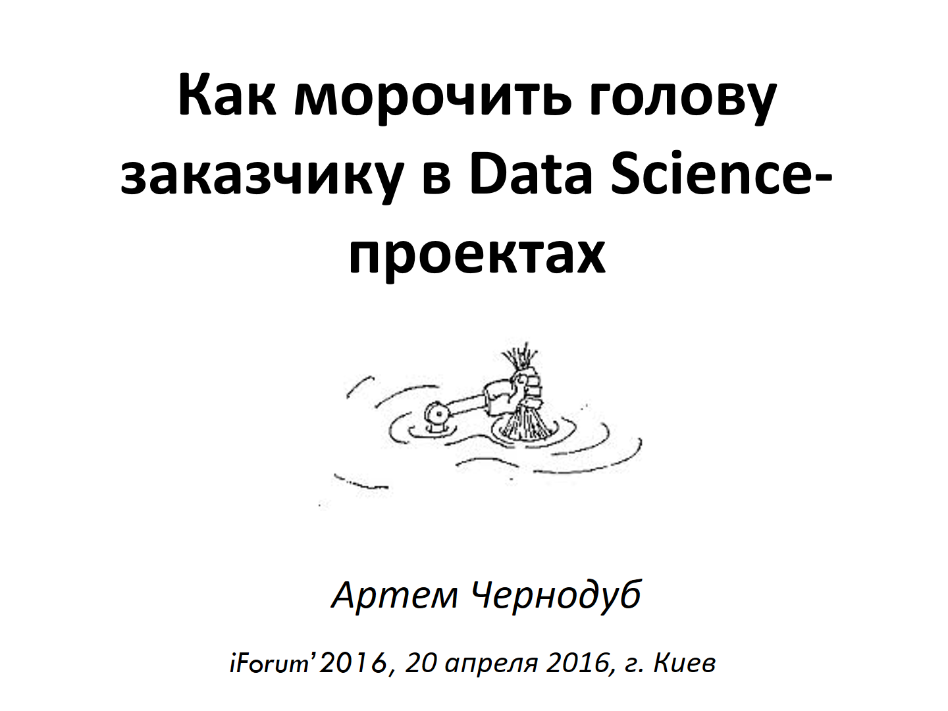

Underwater rocks: specifics of tuning AI algorithms
https://www.youtube.com/watch?v=VlCKZPkp4VQ
40 / 42

Slide 41
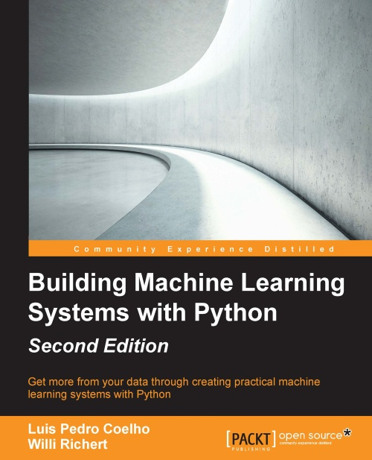

Fresh Machine Learning book for developers
41 / 42

Slide 42

Thanks!
a.chernodub@gmail.com

