Slide 1

EXPERIENCE
Bitcoin, Blockchain
and Smart Contracts
10
years of developing
The technology likely to have the greatest impact on the next few decades has arrived
06
years with e-Commerce
Kudrenko Oleg
03
Spring 2017
years with Blockchain

Slide 2


EXPERIENCE
12
years of developing
06
years with e-Commerce
04
years with Blockchain
Blockchain
and Smart Contracts
The technology likely to have the greatest impact on the next few decades has arrived
Kudrenko Oleg
Fall 2016

Slide 3
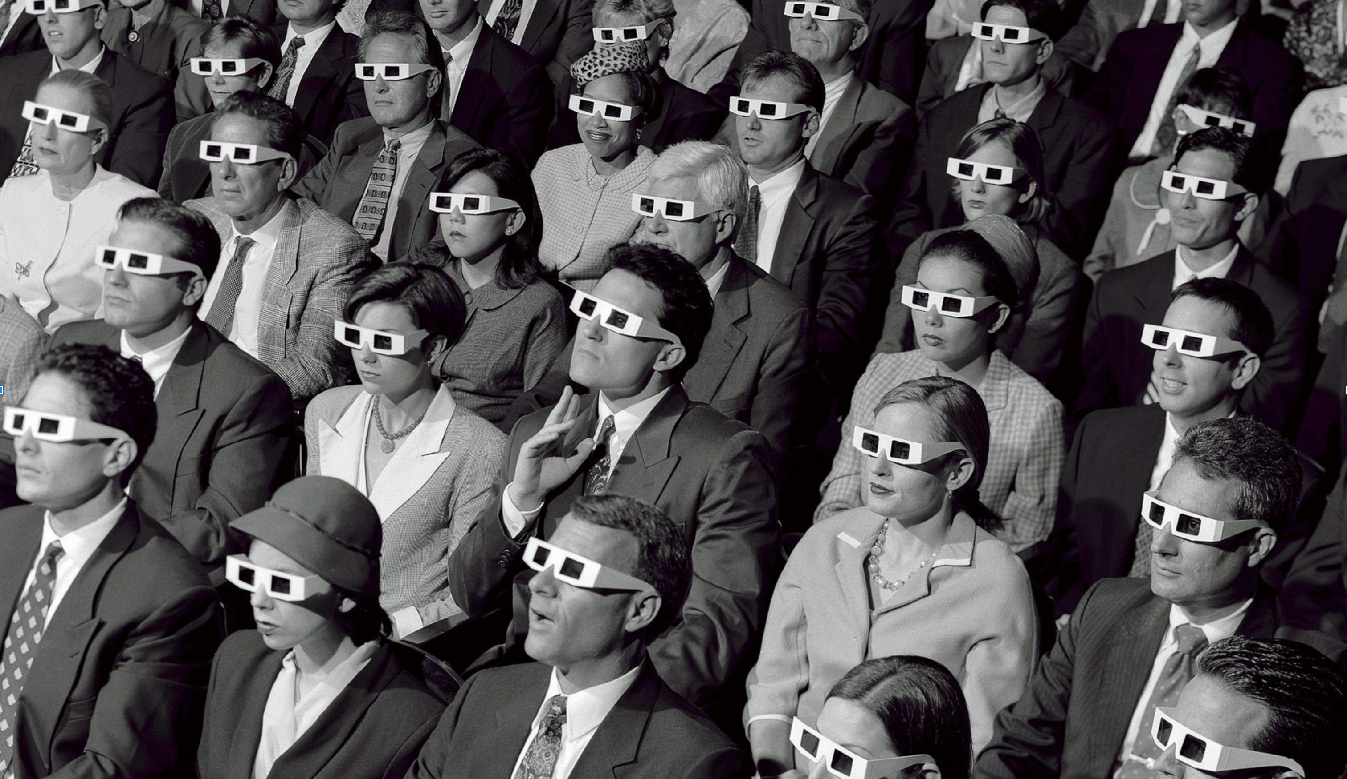
EXPERIENCE
10
years of developing
06
years with e-Commerce
03
years with Blockchain
BLOCKCHAIN

Slide 4

THE TECHNOLOGICAL REVOLUTION
Mobility

Slide 5




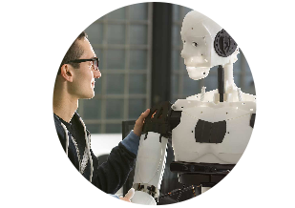
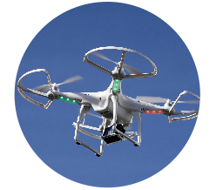
THE TECHNOLOGICAL REVOLUTION
Internet of Things
Mobility
Social Web
Big Data
The Cloud
Machine Learning
Drones & Robotics

Slide 6
THE TECHNOLOGICAL REVOLUTION
Social Web
Mobility
Big Data
BLOCKCHAIN
Internet of Things
The Cloud
Machine Learning
Drones & Robotics

Slide 7


THE INTERNET OF INFORMATION
THE INTERNET OF
INFORMATION

Slide 8





THE INTERNET OF INFORMATION
INFORMATION

Slide 9
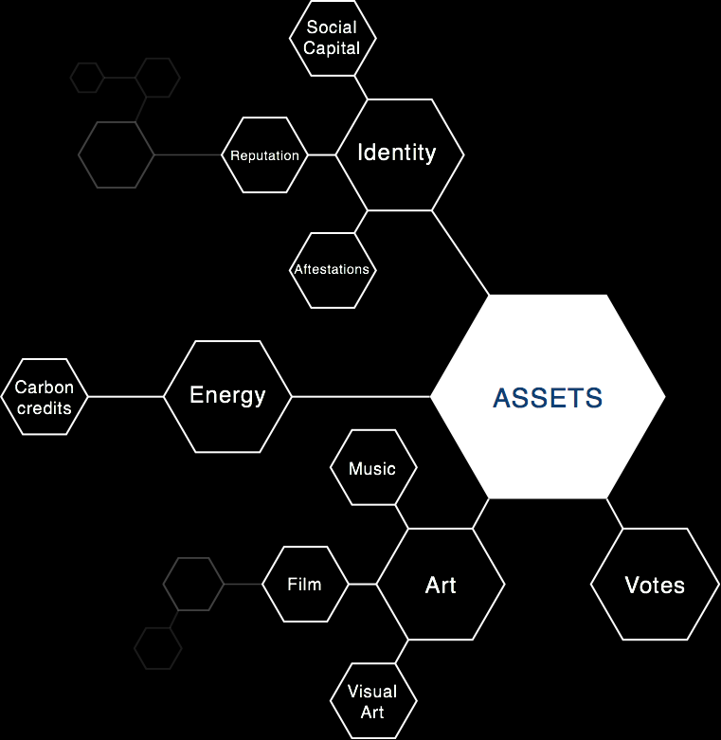

NEEDED:
THE INTERNET OF INFORMATION
AN INTERNET OF VALUE
INFORMATION

Slide 10

NEEDED:
AN INTERNET OF VALUE

Slide 11

NEEDED:
AN INTERNET OF VALUE

Slide 12
THE MIDDLEMAN

Slide 13
THE MIDDLEMAN

Slide 14


INTERNATIONAL WIRE TRANSFER
Sender Bank
THE MIDDLEMAN

Slide 15
INTERNATIONAL WIRE TRANSFER
Sender Bank
Receiver Bank

Slide 16
INTERNATIONAL WIRE TRANSFER
CORRESPONDENT
Sender Bank
Receiver Bank
Slow Bank

Slide 17

INTERNATIONAL WIRE TRANSFER
CORRESPONDENT
Sender Bank
Slow Bank
Receiver Bank

Slide 18
INTERNATIONAL WIRE TRANSFER
CORRESPONDENT
RETHINKING
THE FINANCIAL SERVICES INDUSTRY
Sender Bank
USD
Slow Bank
EUR
Receiver Bank

Slide 19
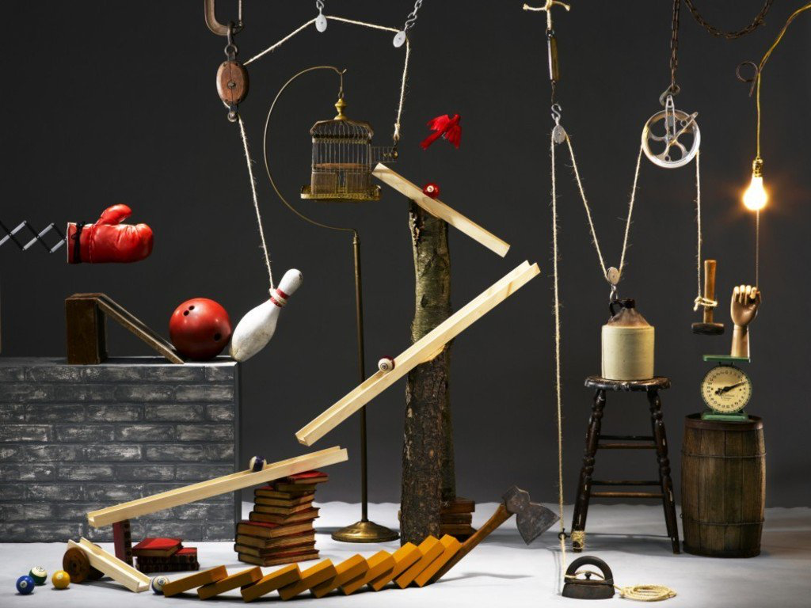
10
^
9
RETHINKING
THE FINANCIAL SERVICES INDUSTRY

Slide 20
10
^
9
RETHINKING
THE FINANCIAL SERVICES INDUSTRY
NEEDED:
AN INTERNET OF VALUE

Slide 21
^
NEEDED:
AN INTERNET OF VALUE
10
9

Slide 22


Slide 23



WHO IS SATOSHI NAKAMOTO?

Slide 24
WHO IS SATOSHI NAKAMOTO?

Slide 25
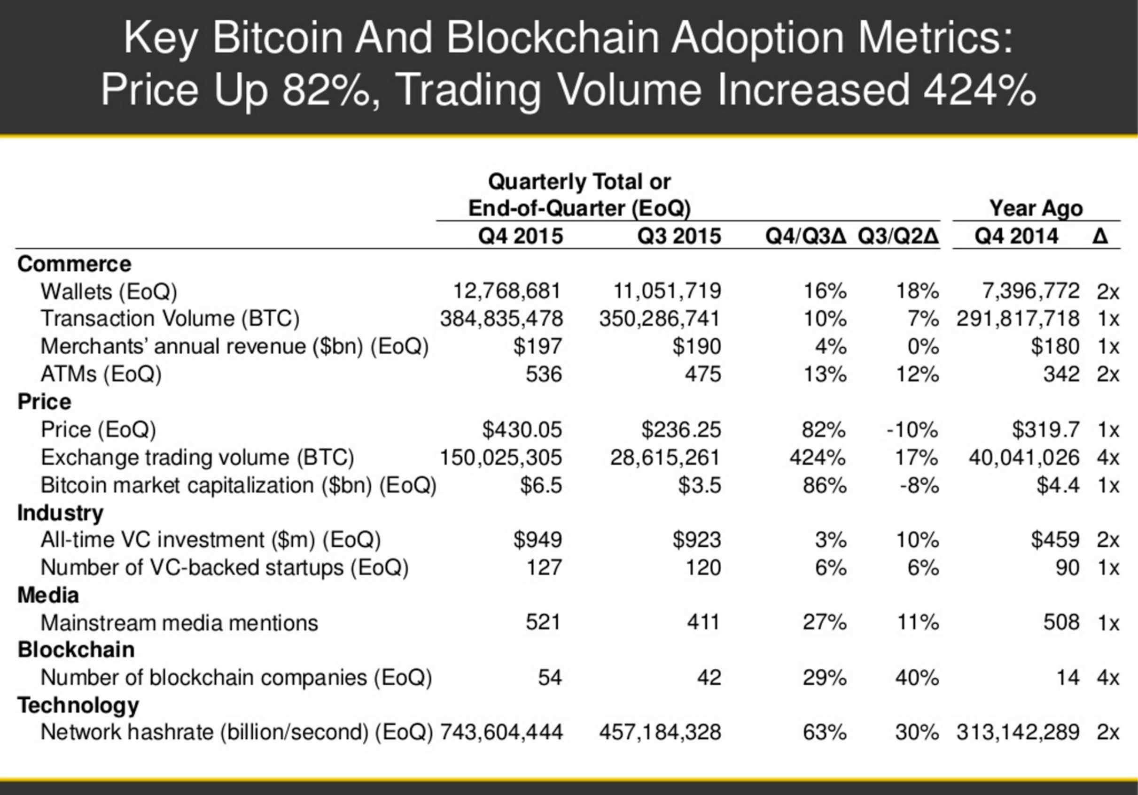

Slide 26
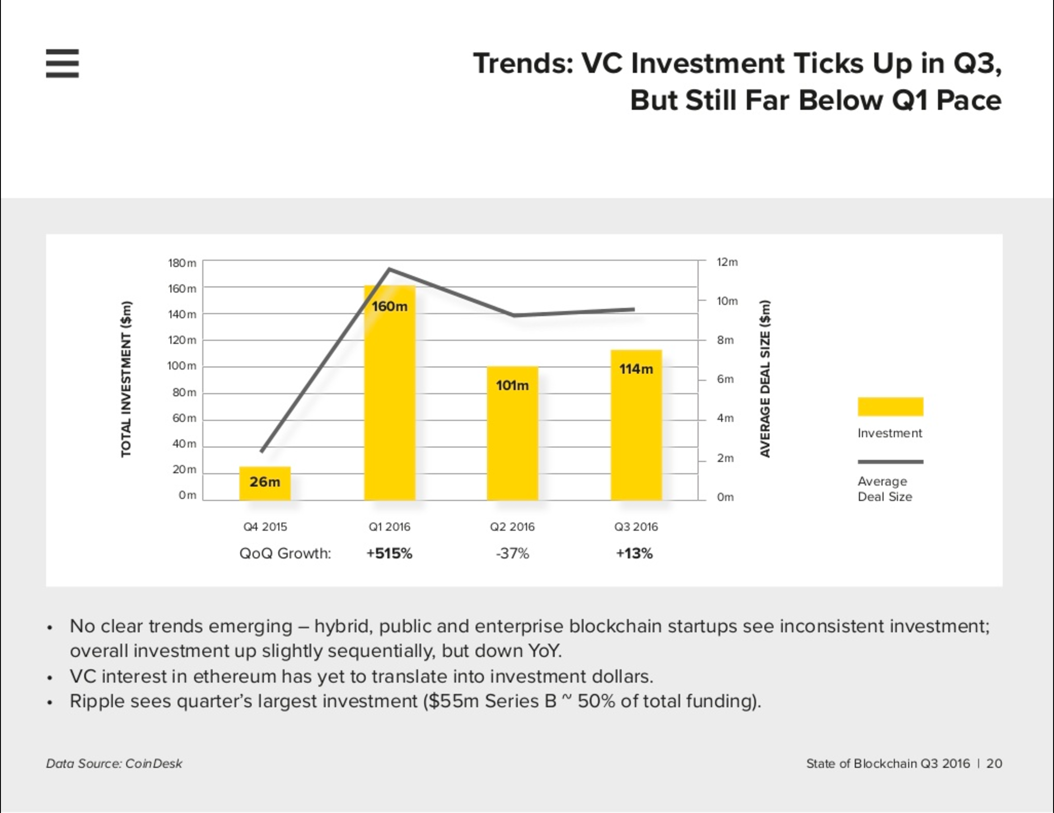

Slide 27
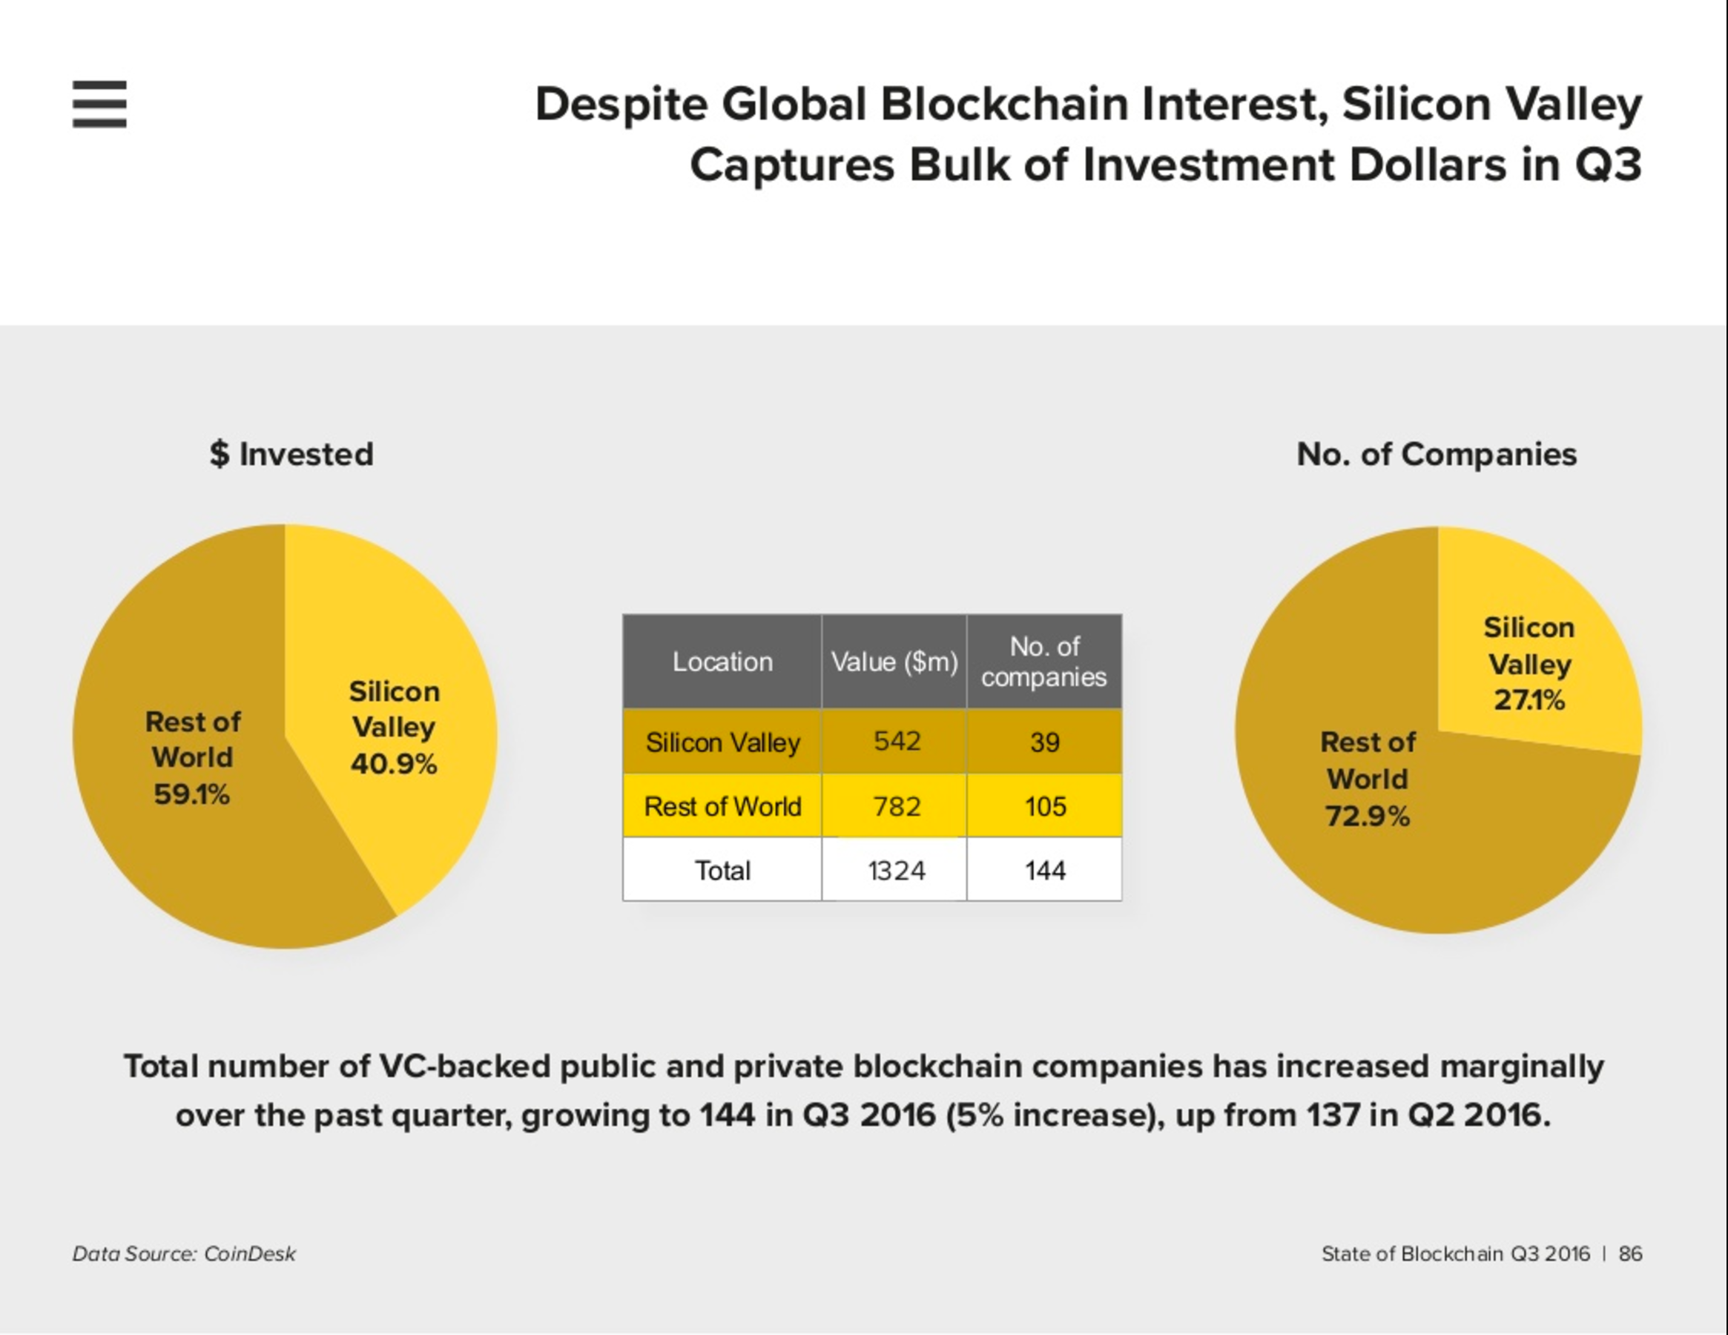

Slide 28



exchange (absolute liquidity)
What is
money?
cost estimate
accumulation of funds

Slide 29
exchange (absolute liquidity)
What is
money?
cost estimate
accumulation of funds

Slide 30
What is
money?
VOLATILITY

Slide 31
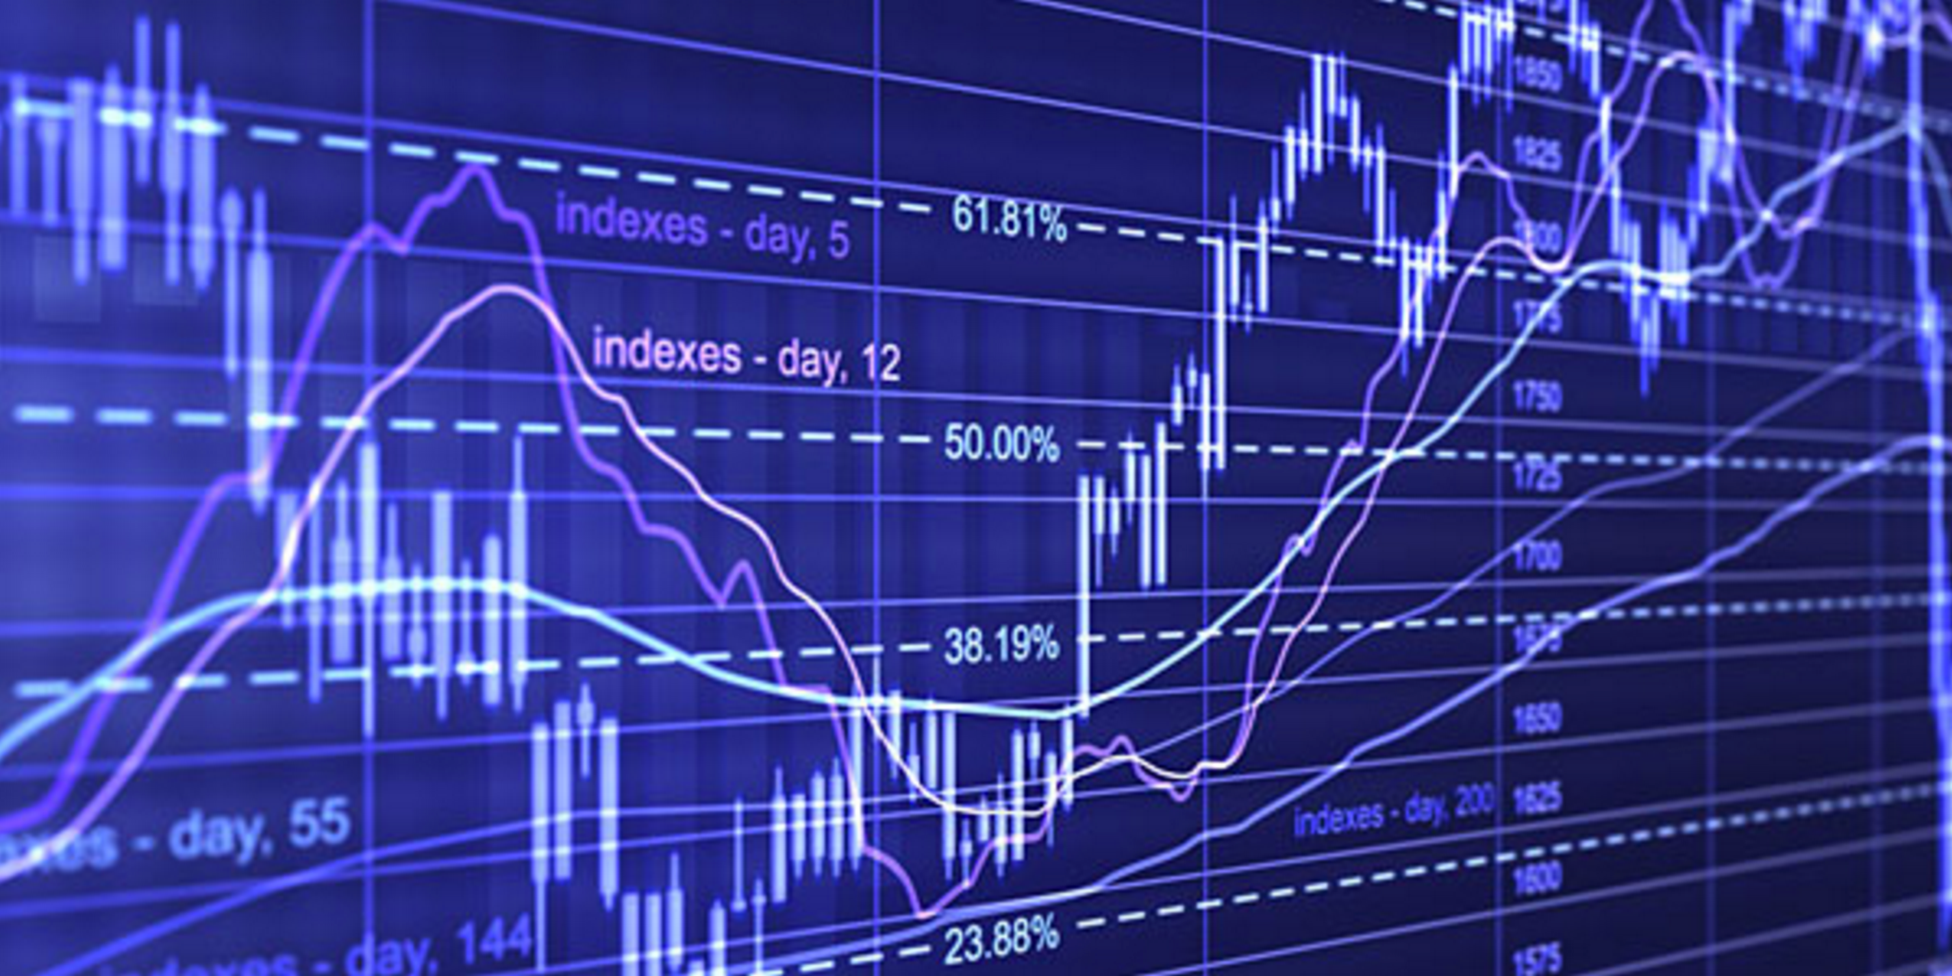

Slide 32
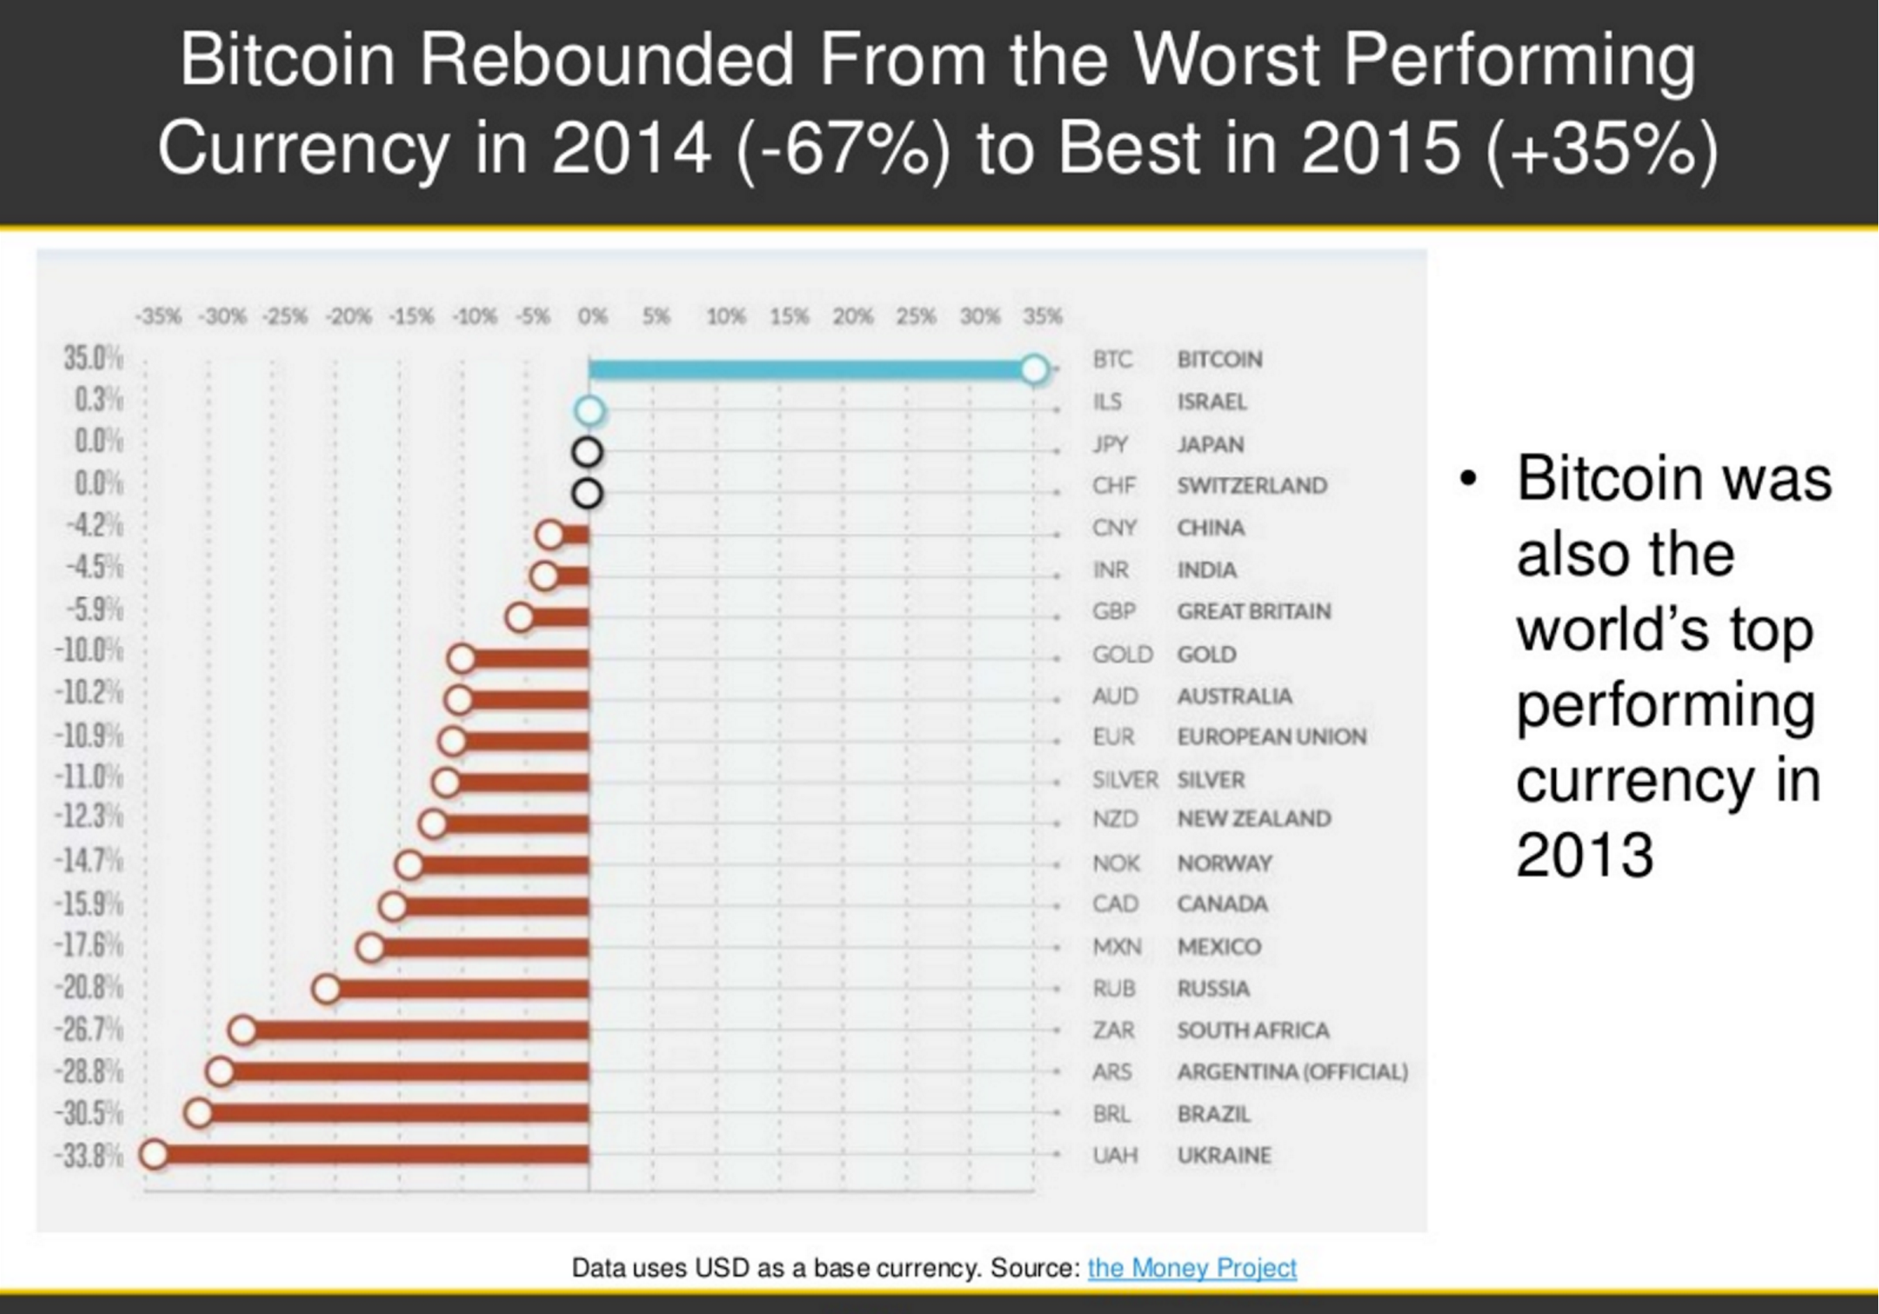
Популярные вопросы
о Биткоин среди пользователей
FAQ
Что делает Биткоин интересным?
Является ли биткоин средством инвестирования?
Как можно купить биткоины?
Как хранить биткоины?
Насколько безопасно хранить биткоины?
Как потратить биткоины?

Slide 33
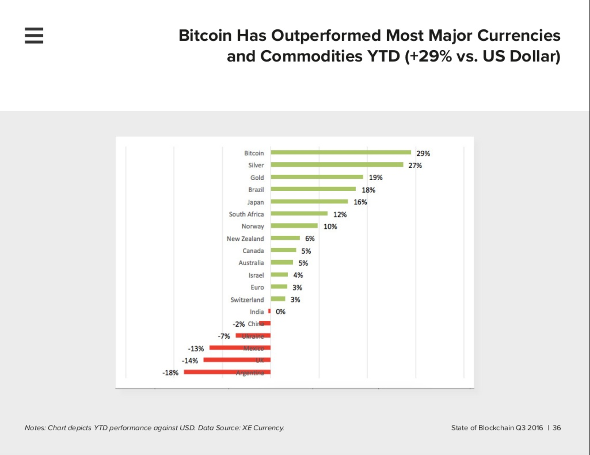

Slide 34
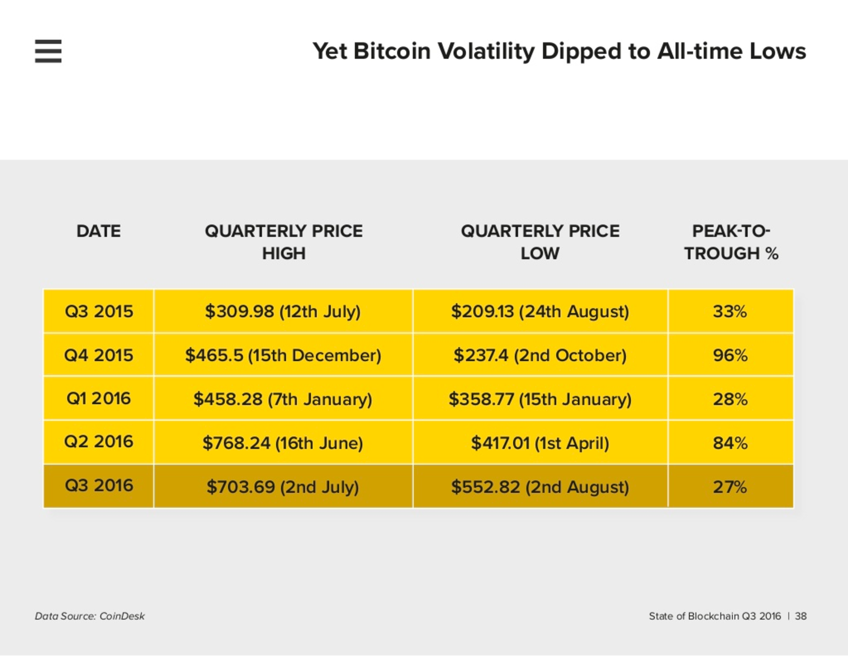

Slide 35
Популярные вопросы
о Биткоин среди пользователей
FAQ
Что делает Биткоин интересным?
Является ли биткоин средством инвестирования?
Как можно купить биткоины?
Как хранить биткоины?
Насколько безопасно хранить биткоины?
Как потратить биткоины?
Bitcoin & Business
What merchant need to know to sell products for Bitcoins

Slide 36
FAQ
Bitcoin & Business
What merchant need to know to sell products for Bitcoins

Slide 37
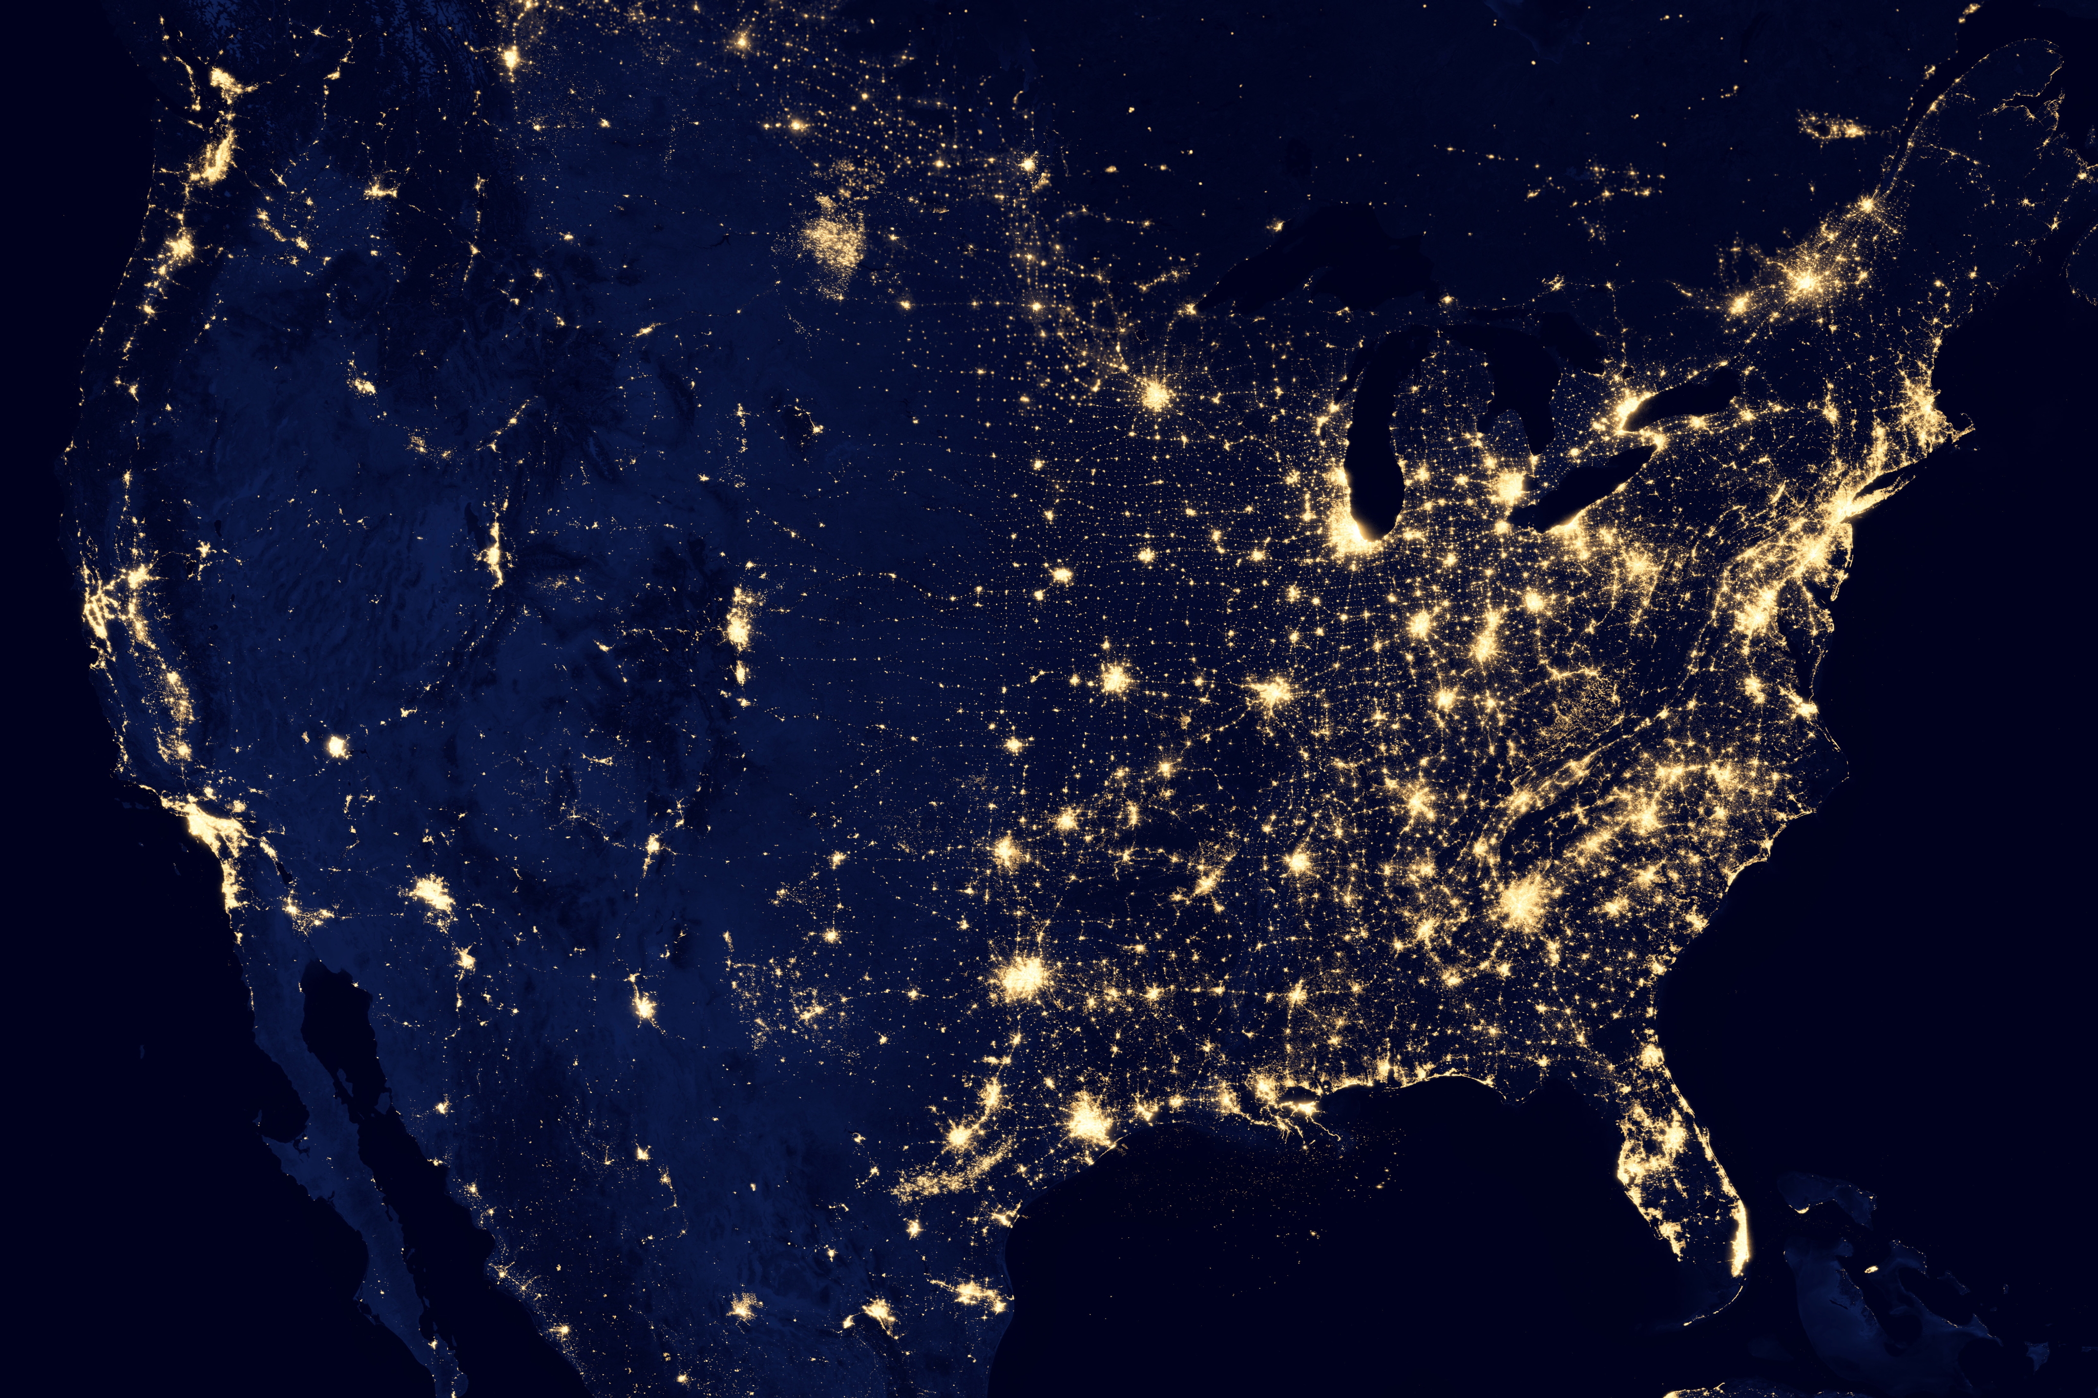
Bitcoin & Business
What merchant need to know to sell products for Bitcoins
BLOCKCHAIN

Slide 38


BLOCKCHAIN
decentralization
ENCYCLOPEDIA BRITANICA
WIKIPEDIA
Centralized
Content
Decentralized
Content

Slide 39
immutable

Slide 40
Smart contracts

Slide 41
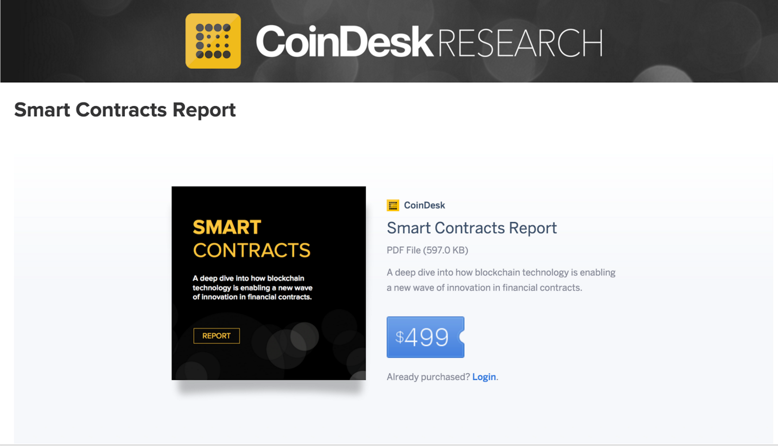

Slide 42
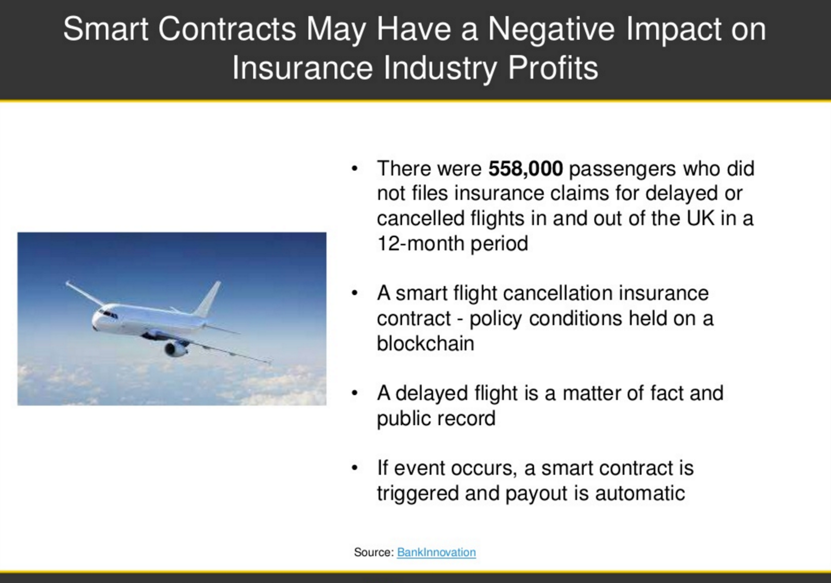

Slide 43
Contacting external services

Slide 44




Contacting external services
Bitcoin
Blockchain
Bitcoin
Blockchain
Ethereum
Blockchain
Ethereum
Blockchain
Internet
Internet

Slide 45
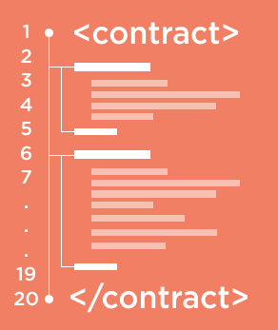

Contacting external services
Bitcoin
Blockchain
Bitcoin
Blockchain
Ethereum
Blockchain
Ethereum
Blockchain
Oraclize
Internet
Internet

Slide 46
Enforcing on-chain payments

Slide 48
Flight delay insurance

Slide 49




Flight delay insurance
Flight statistic
13. Flight data
2. Gets insurance rate
4. Verifies insurance rate
Flights datafeed
5. Verifies flight info
Insurance rate provider
Scheduler
6. Departure info
12. Insured case
1.Get Insurance Rate
3. Create insurance
14. Insurance case validation
7. Insured case
Customer
Sales
11. Signed payment approval
Deloitte
Blockchain Smart Contract
9. Make payment
8. Insured case payment
10. Signed payment approval
Bank
Payment processor

Slide 50
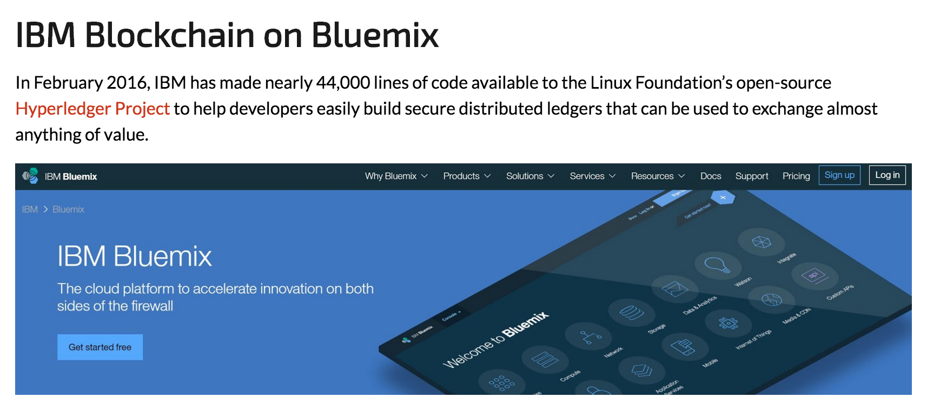

Slide 51
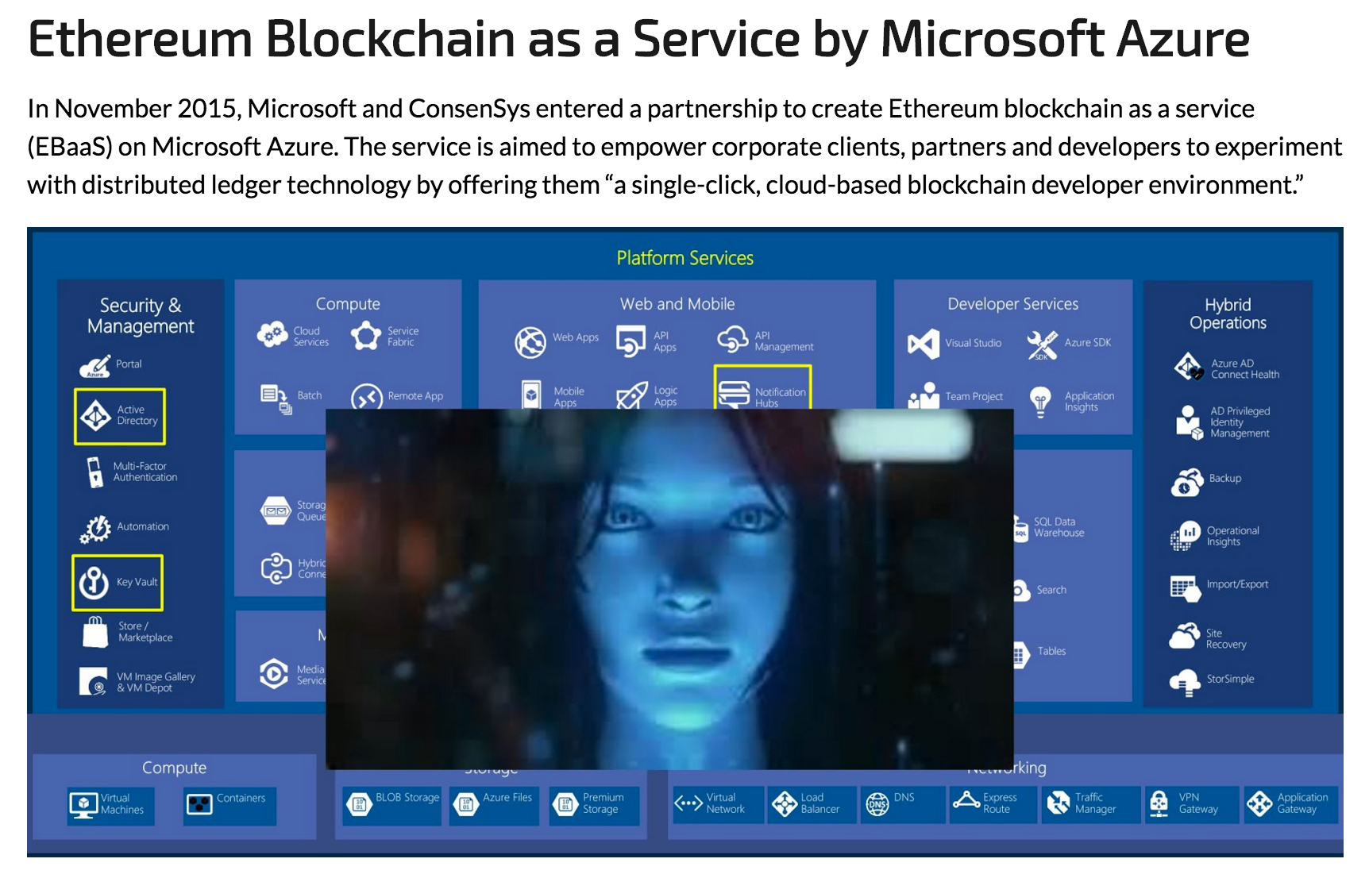

Slide 52
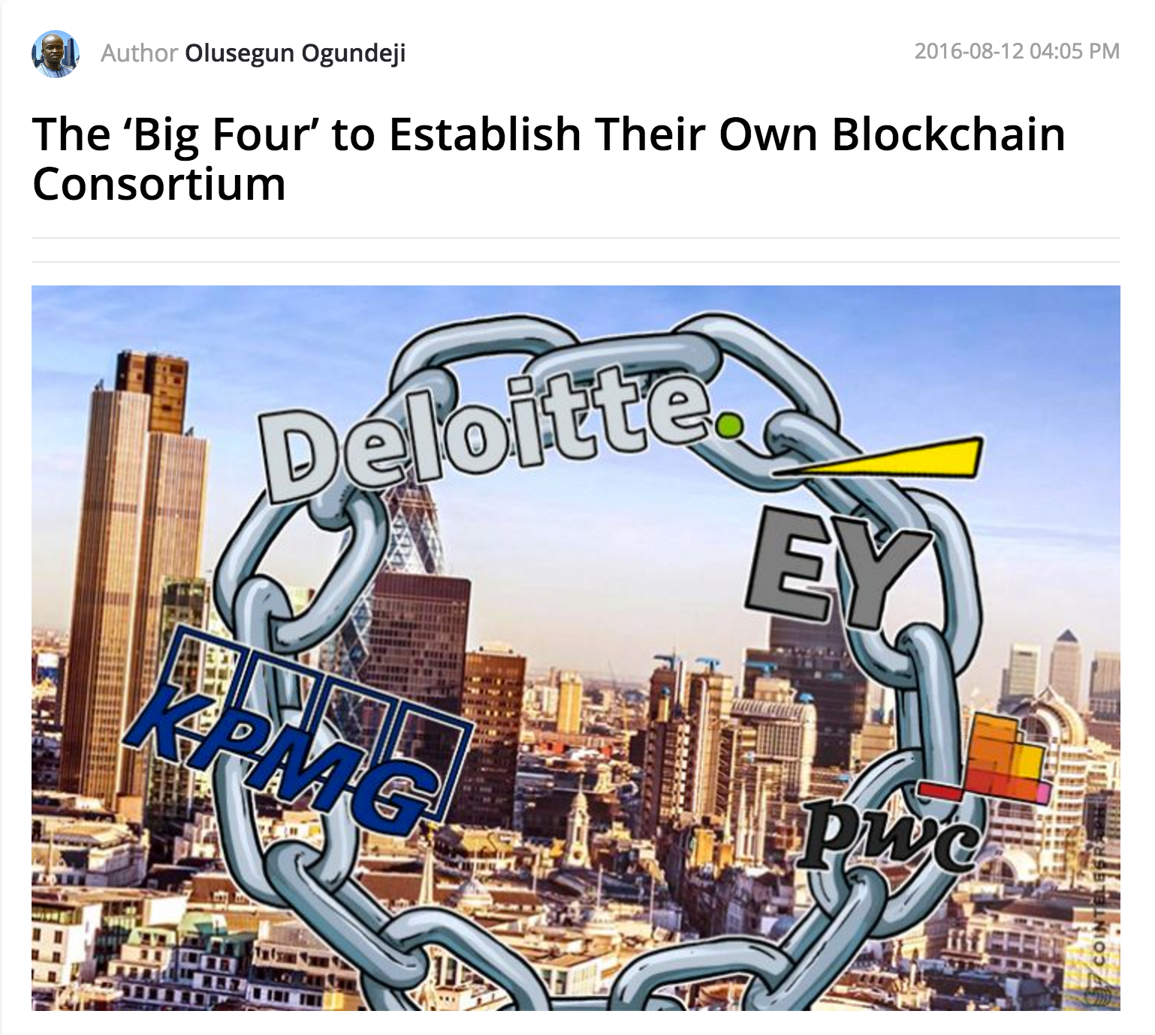

Slide 53
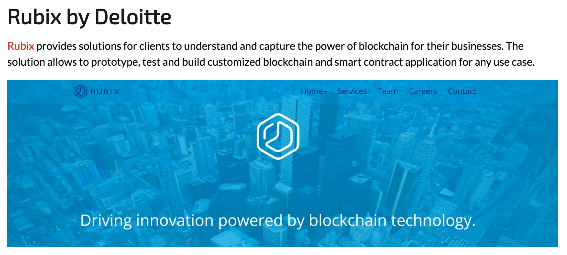

Slide 54
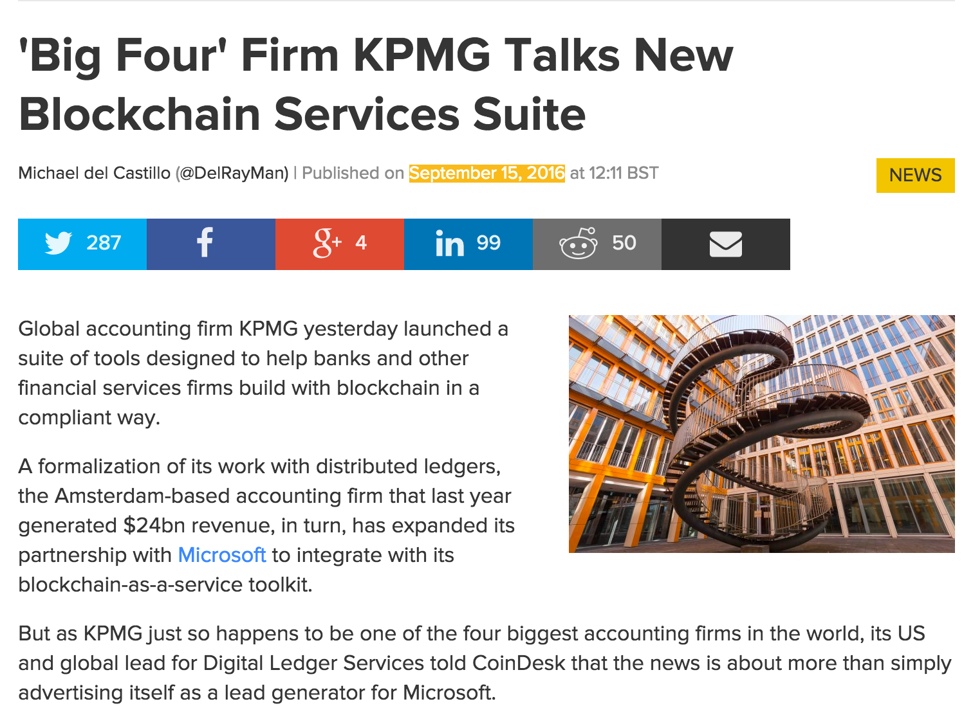

Slide 55
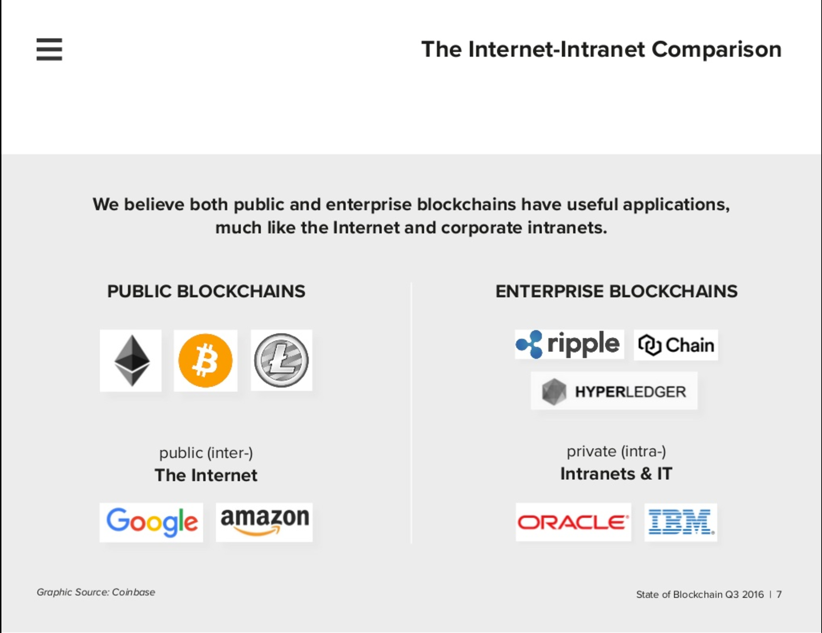

Slide 56
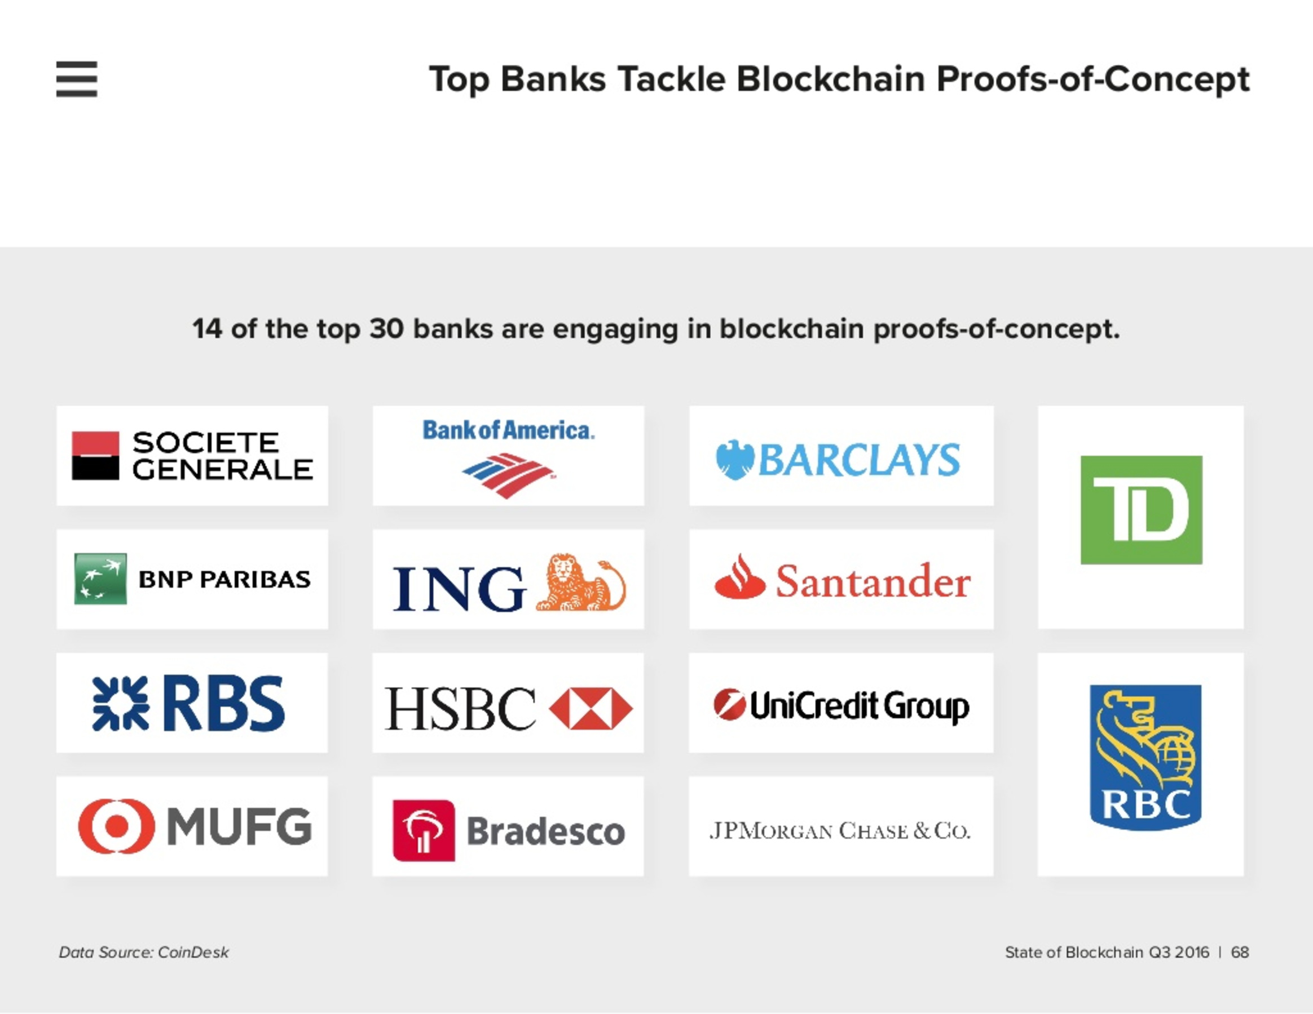

Slide 57
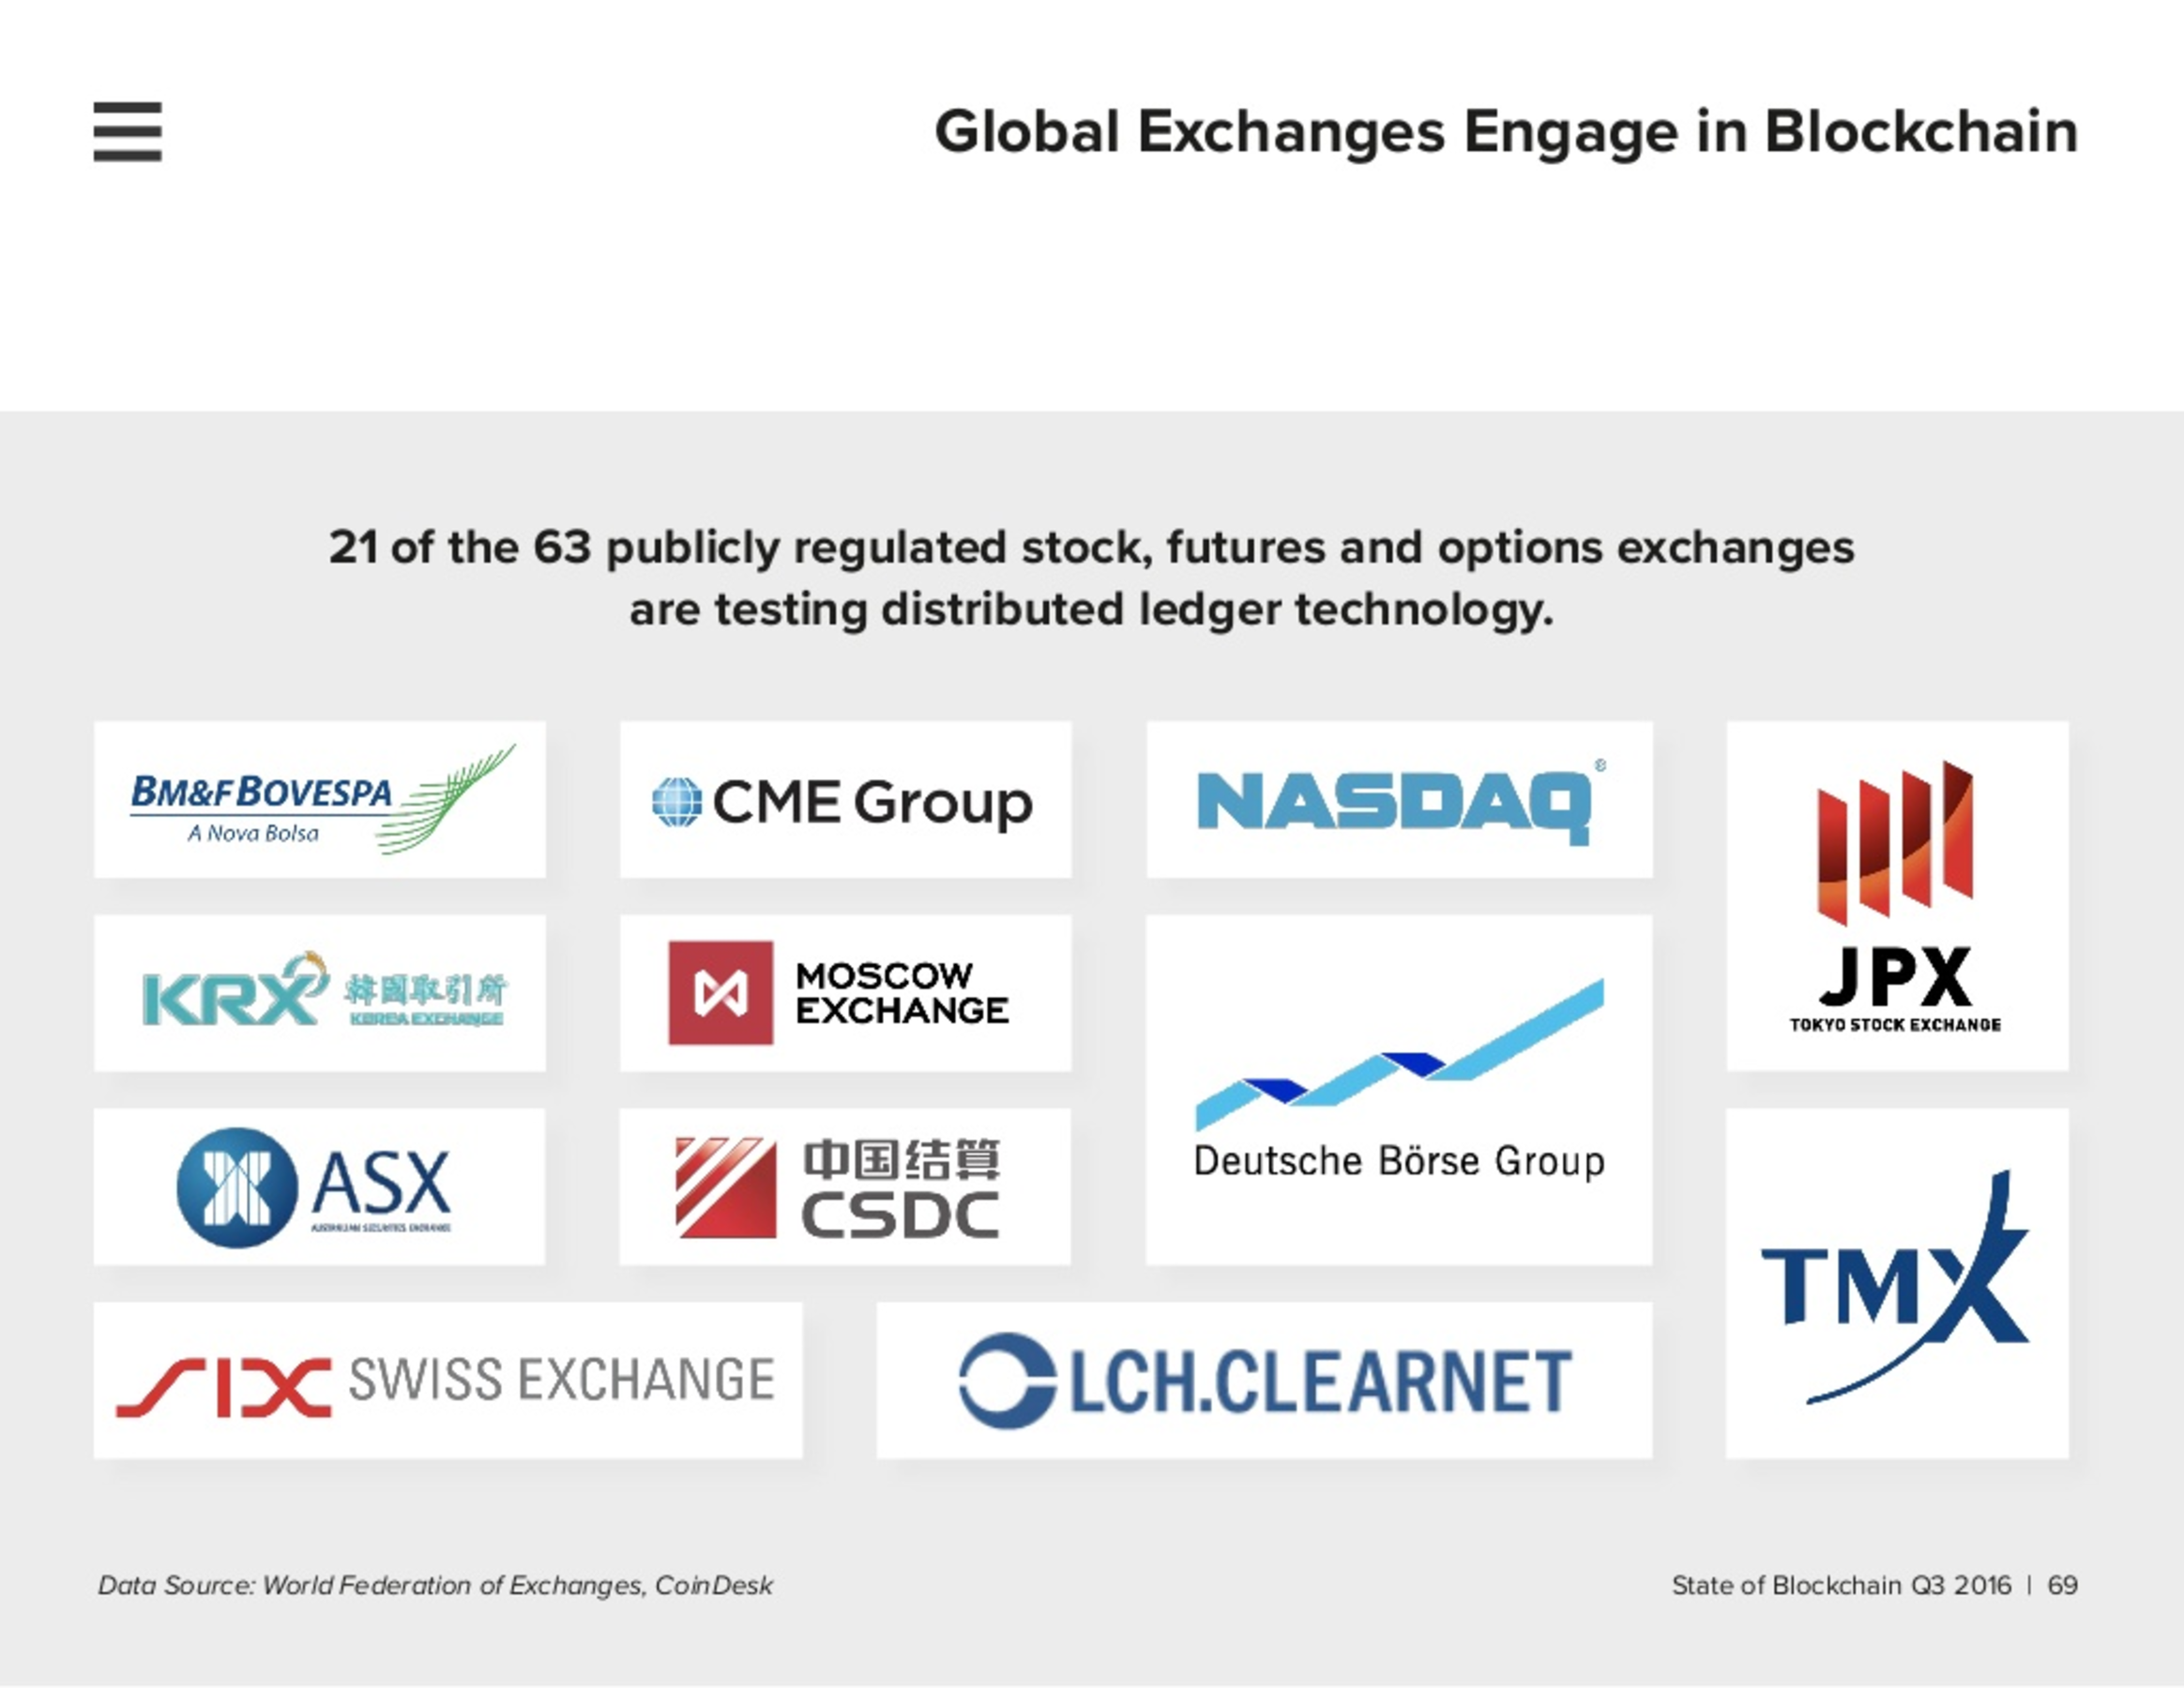

Slide 58
ICO

Slide 59
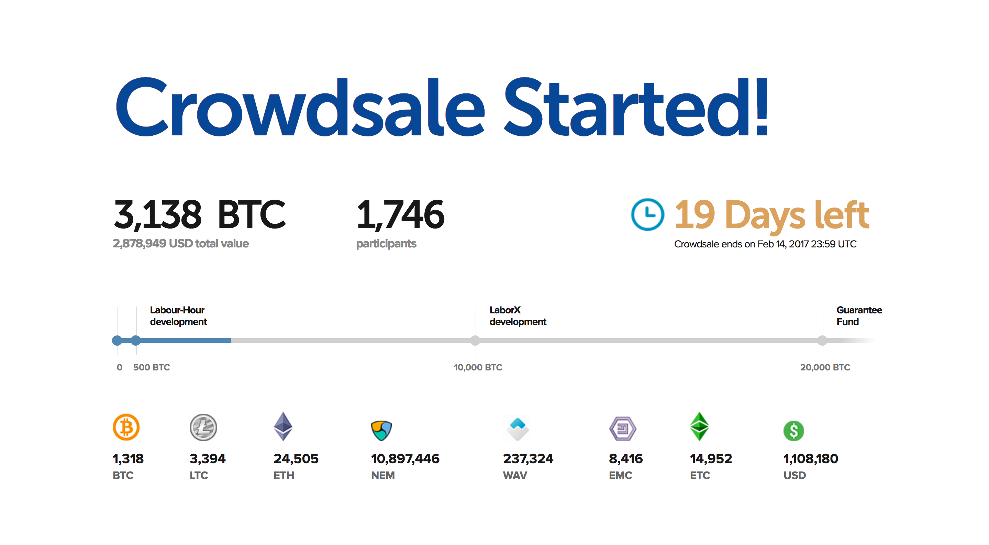

Slide 60
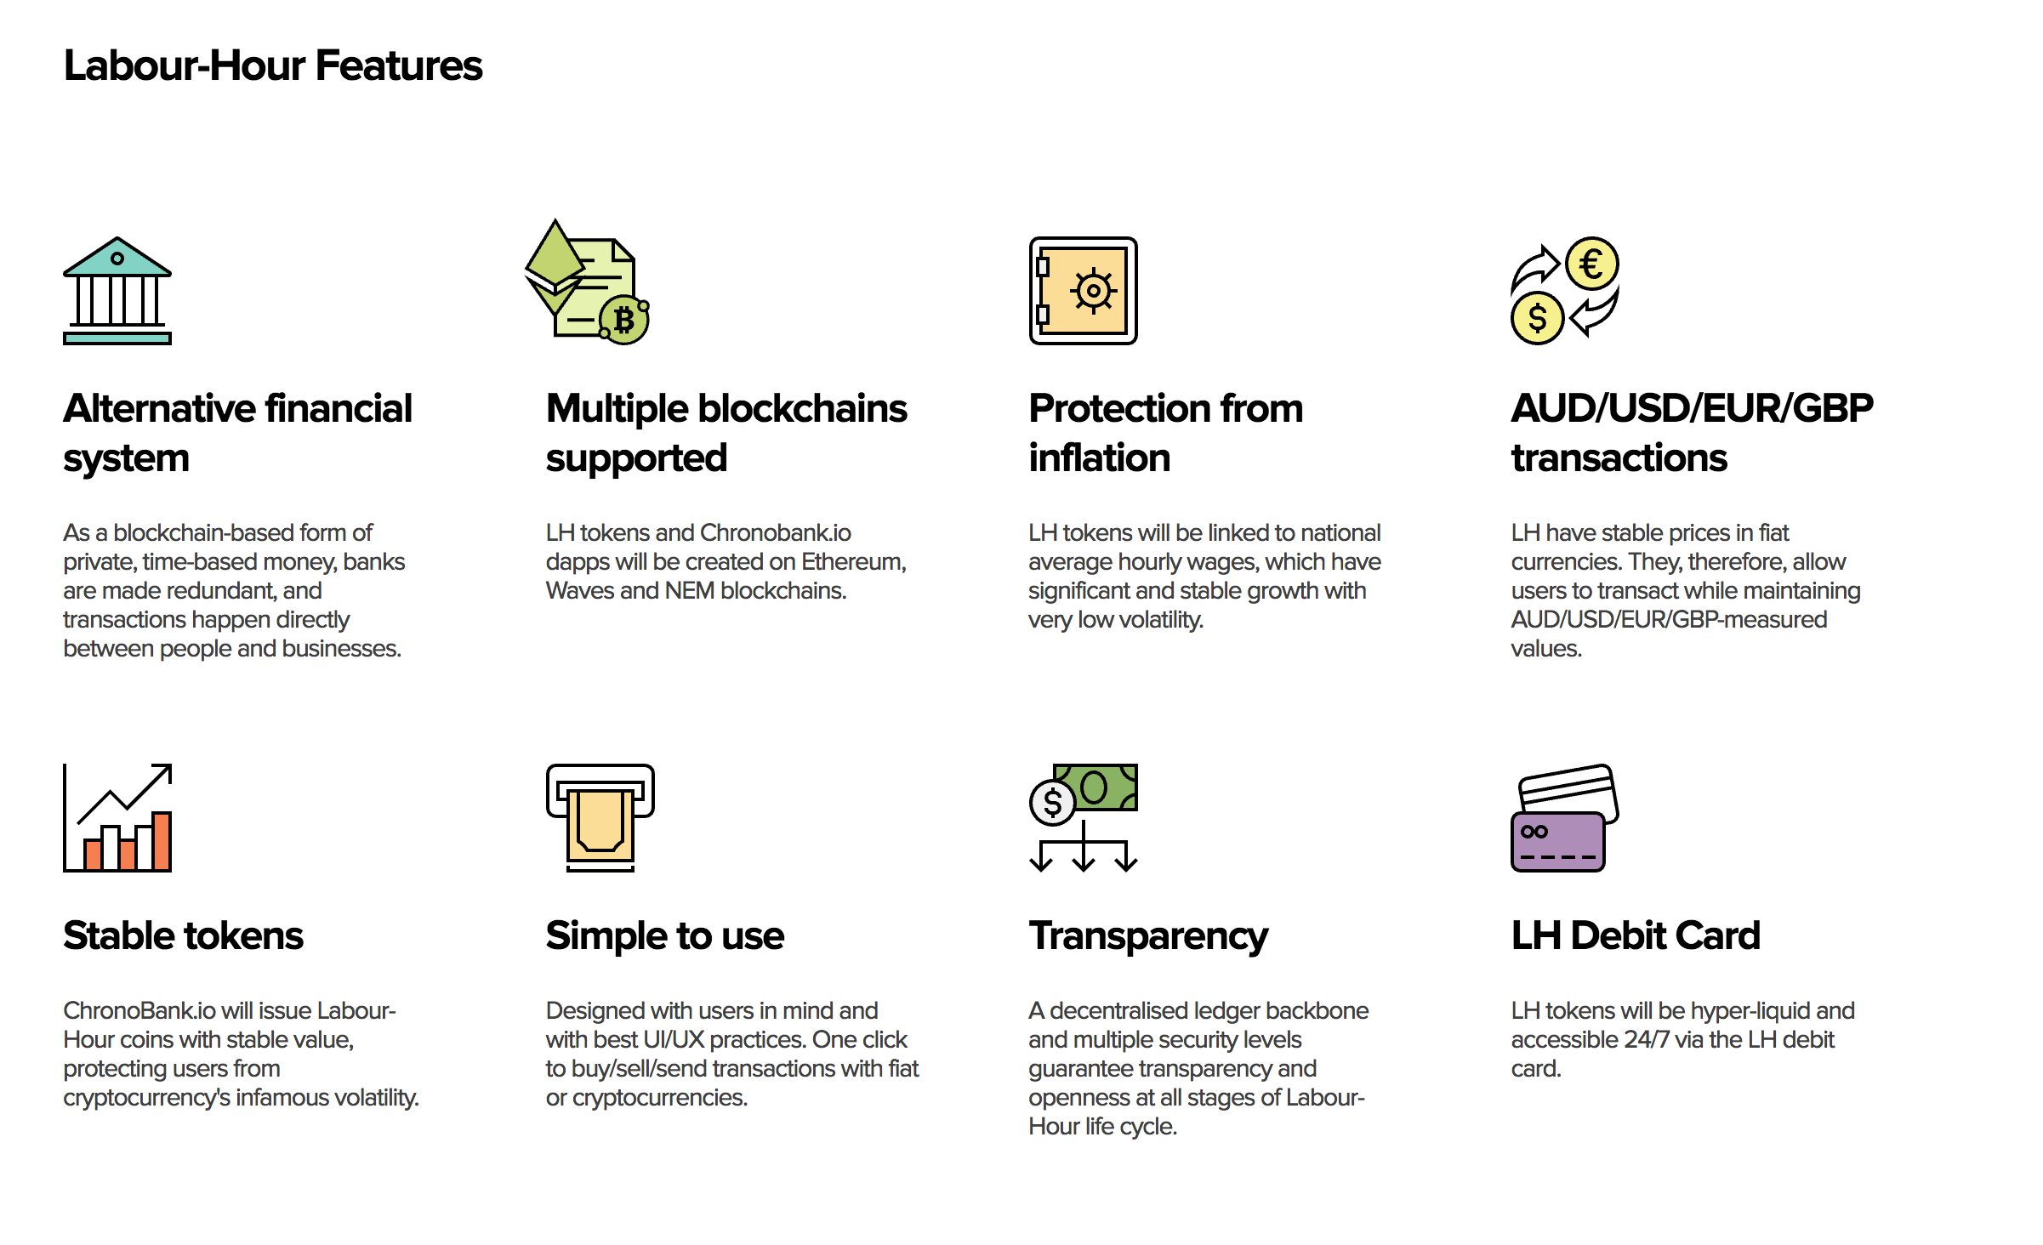

Slide 61
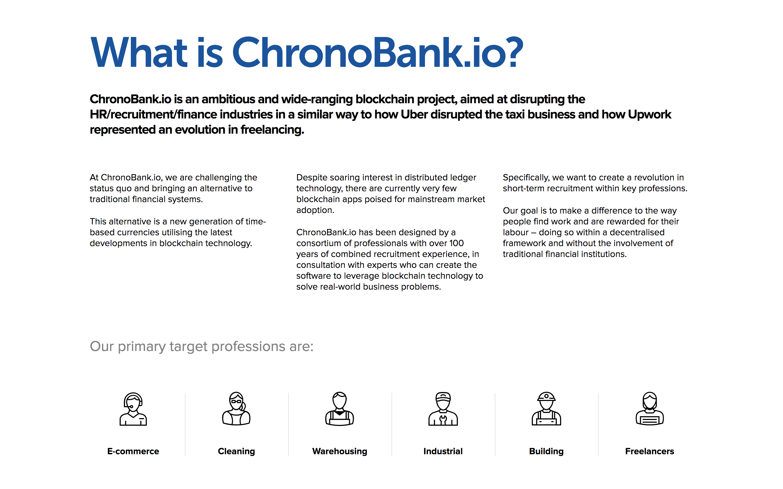

Slide 62
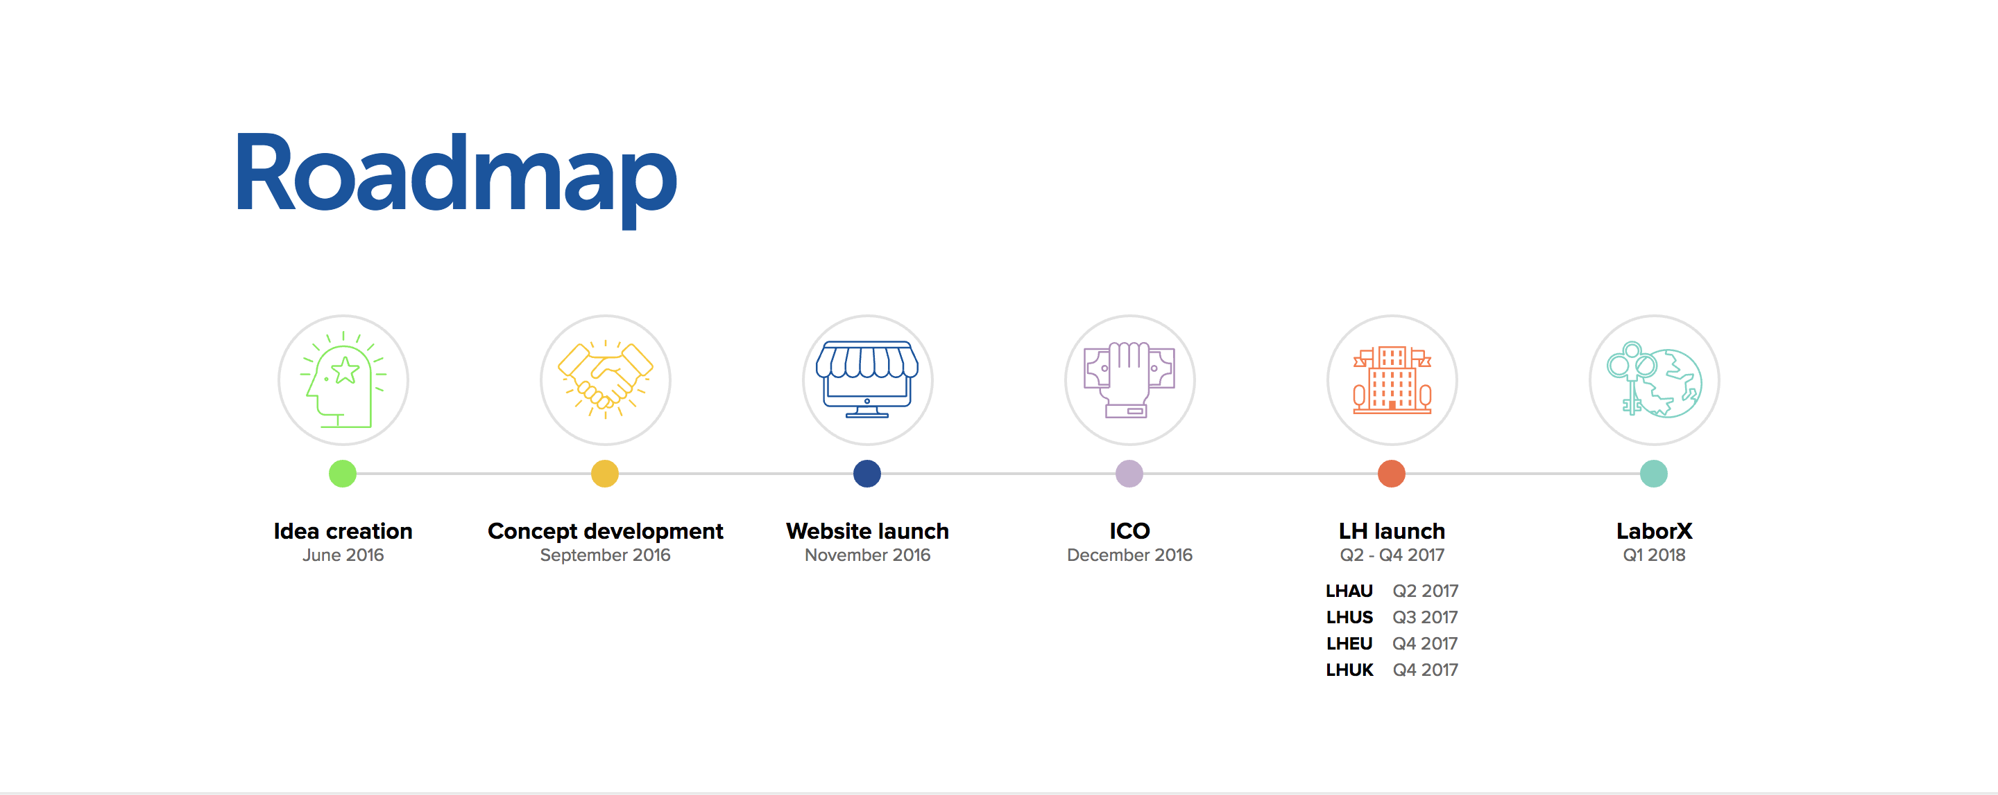

Slide 63
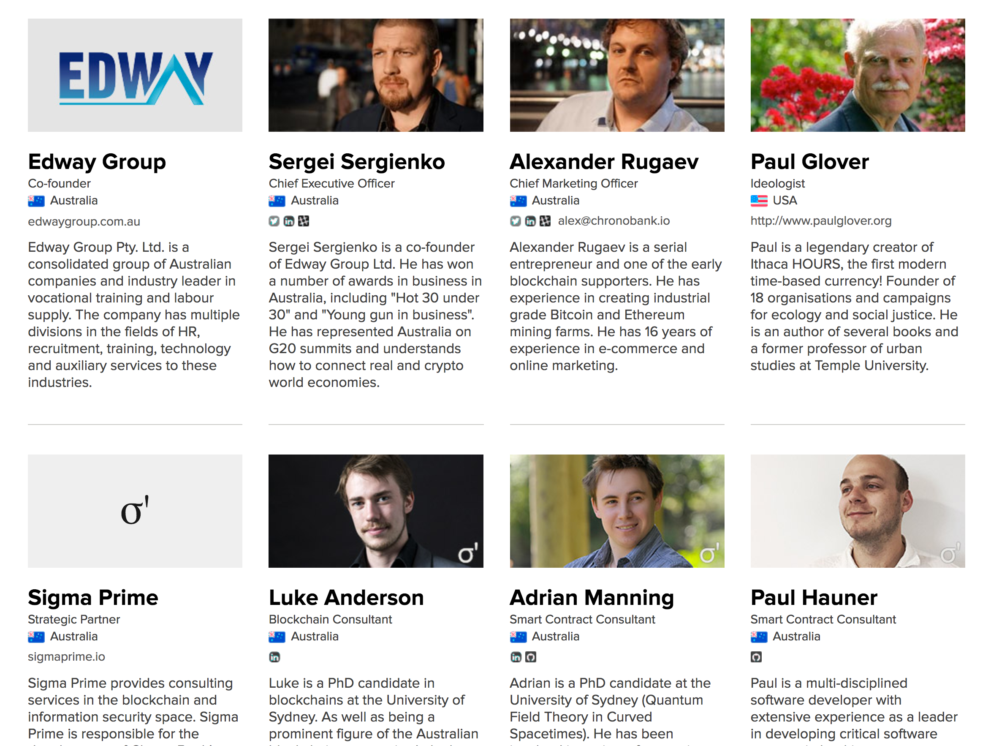

Slide 64
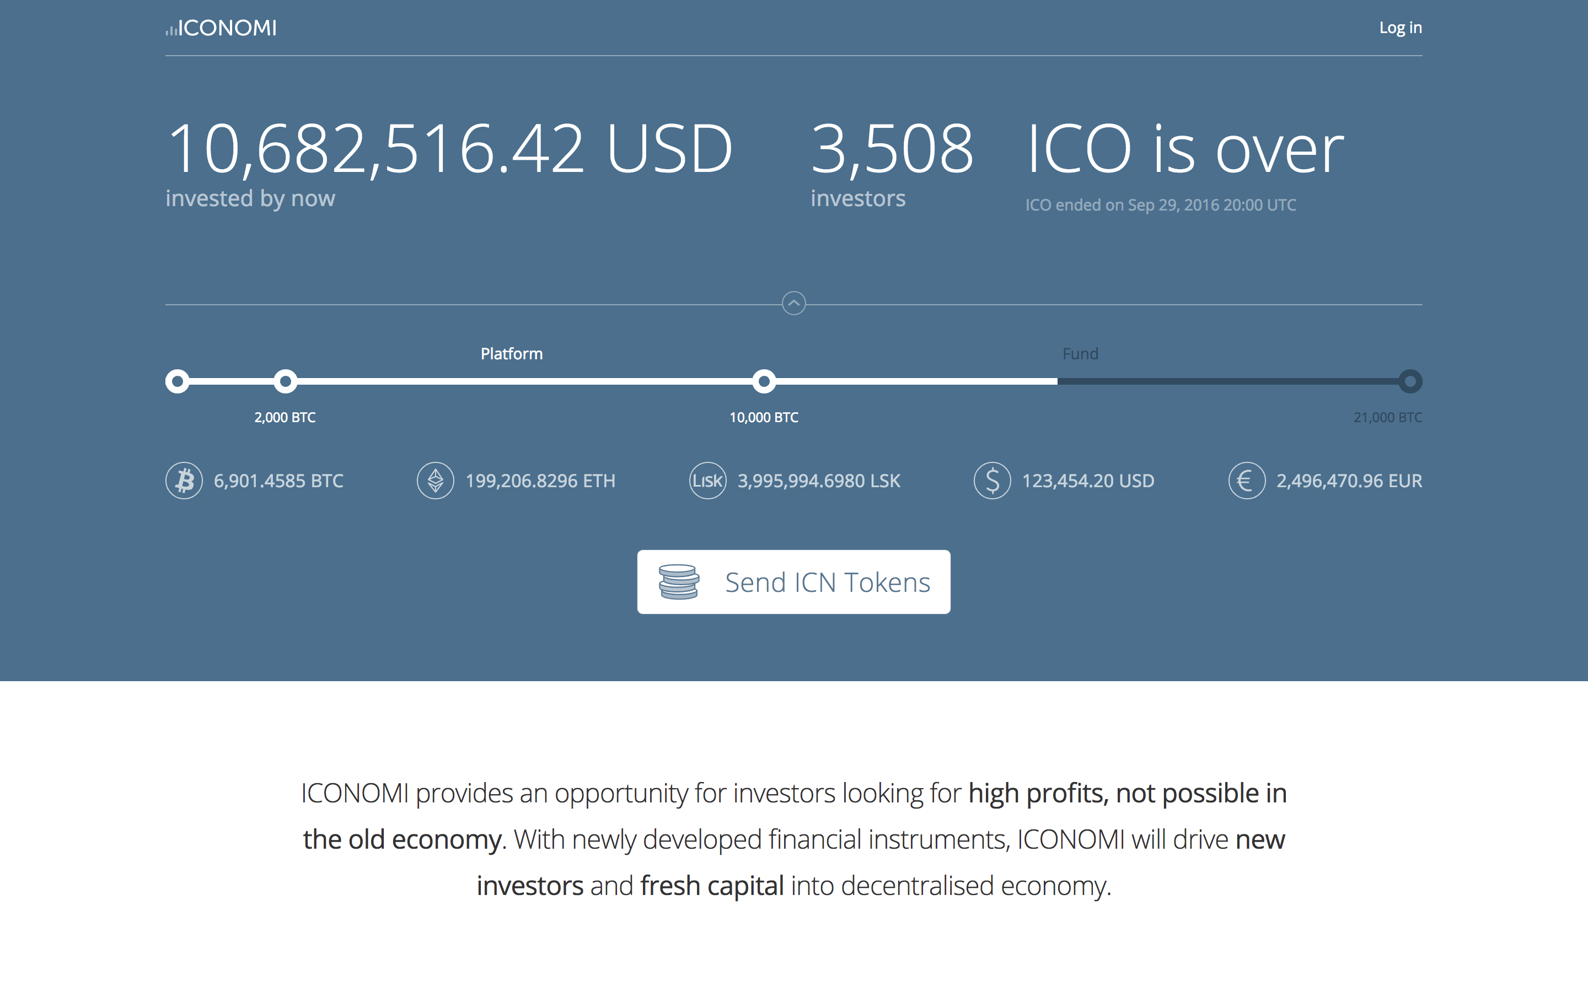

Slide 65
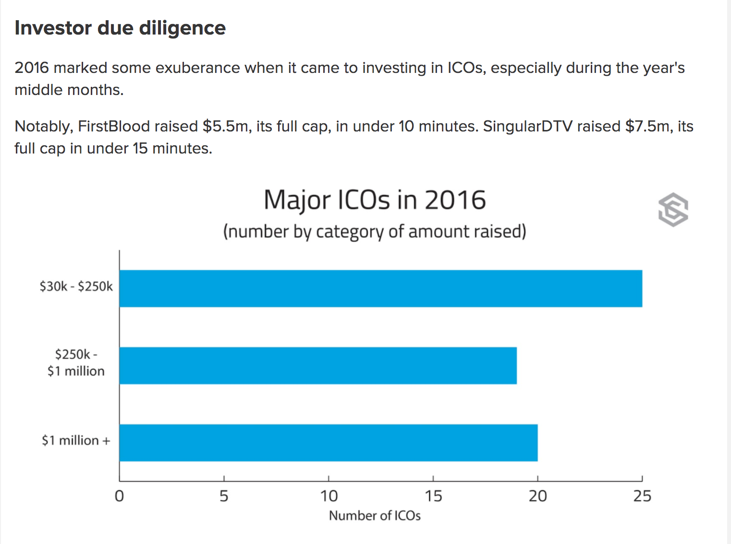

Slide 66
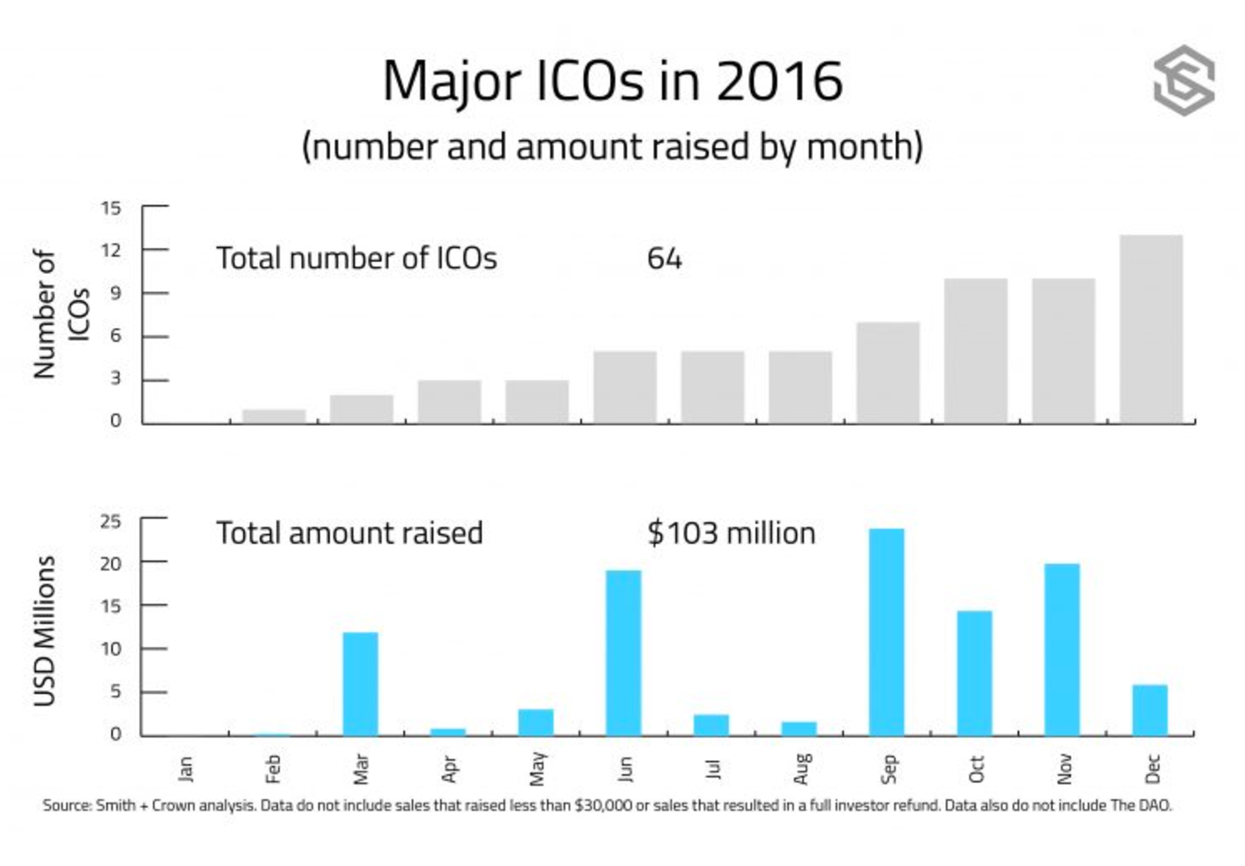

Slide 67
Point of interest

Slide 68
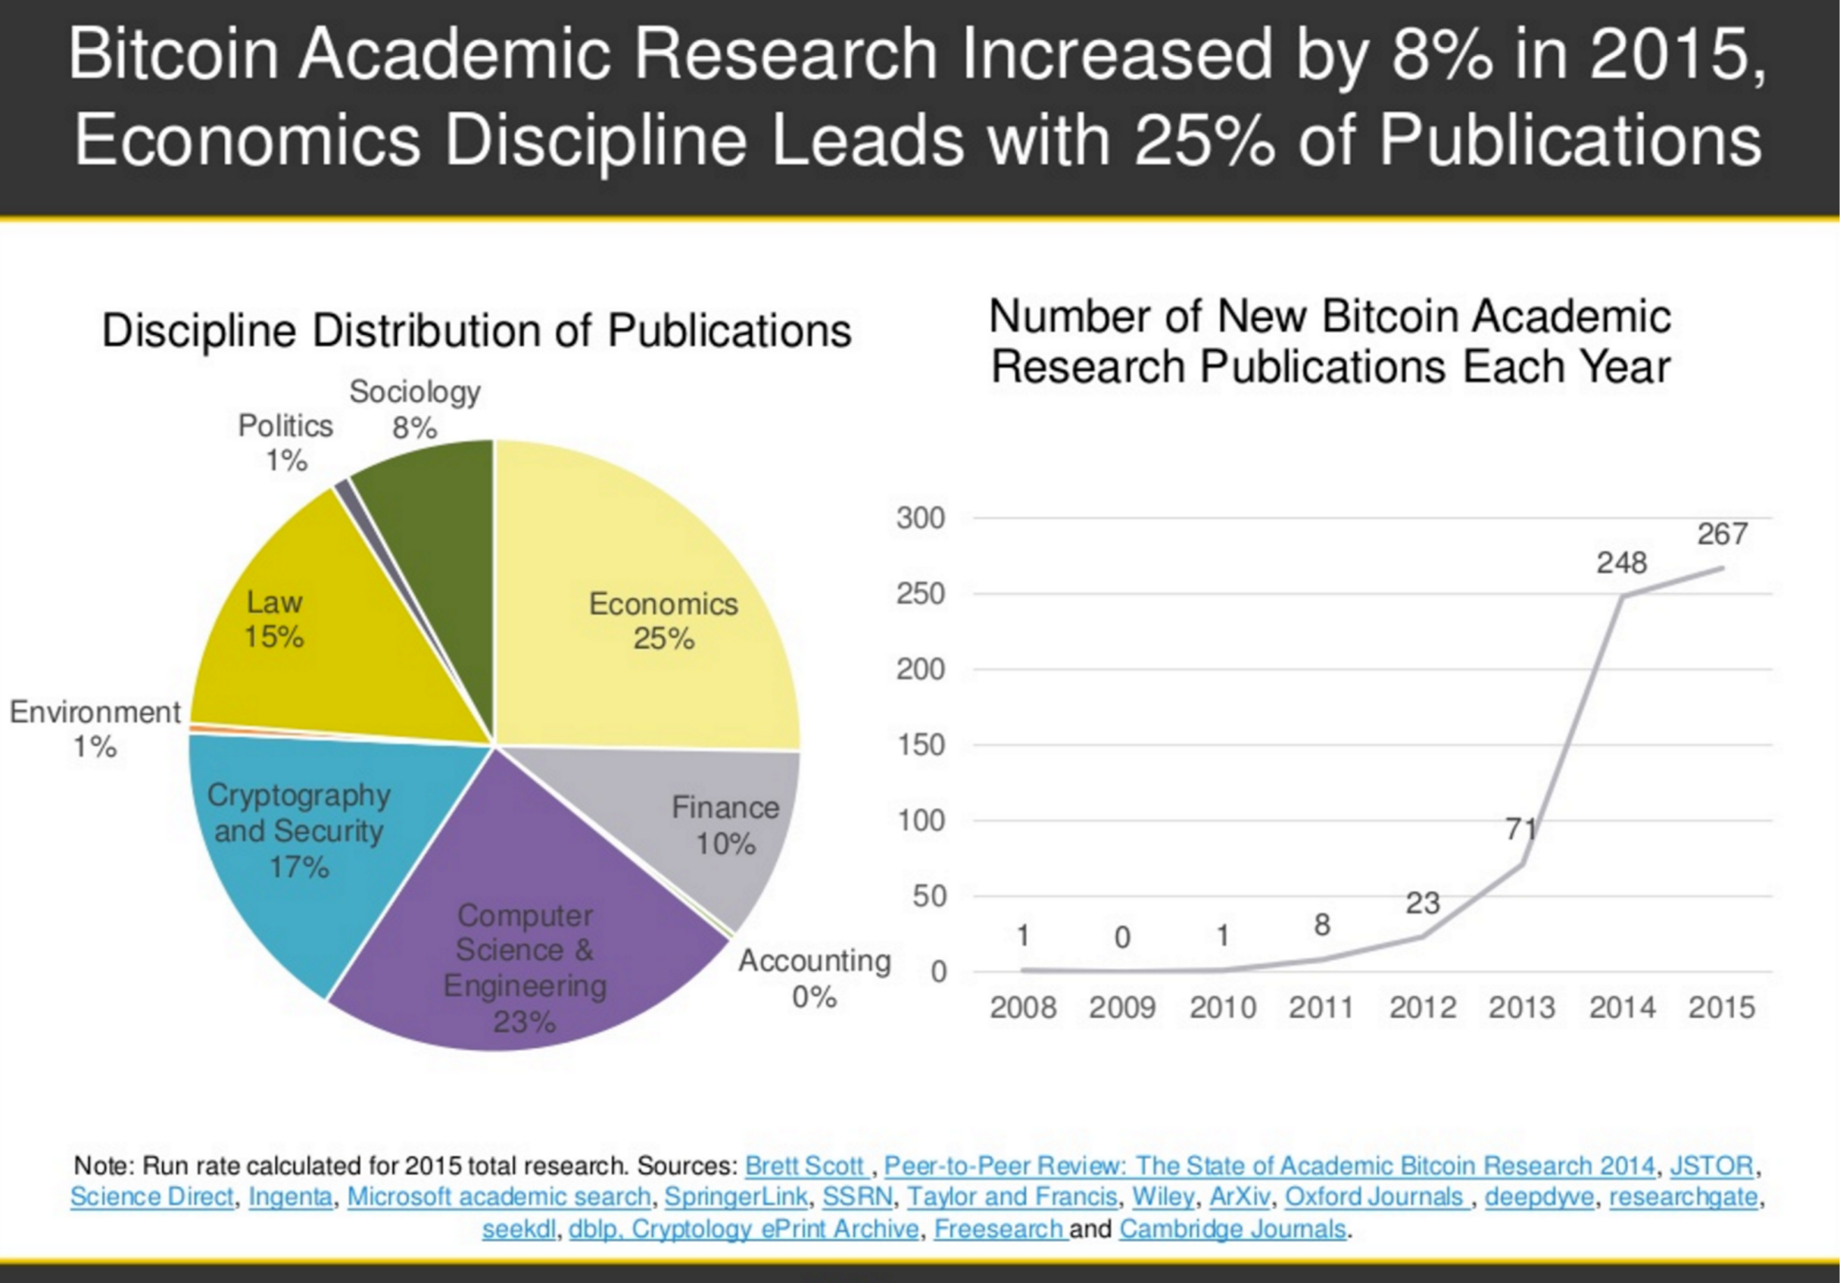

Slide 69
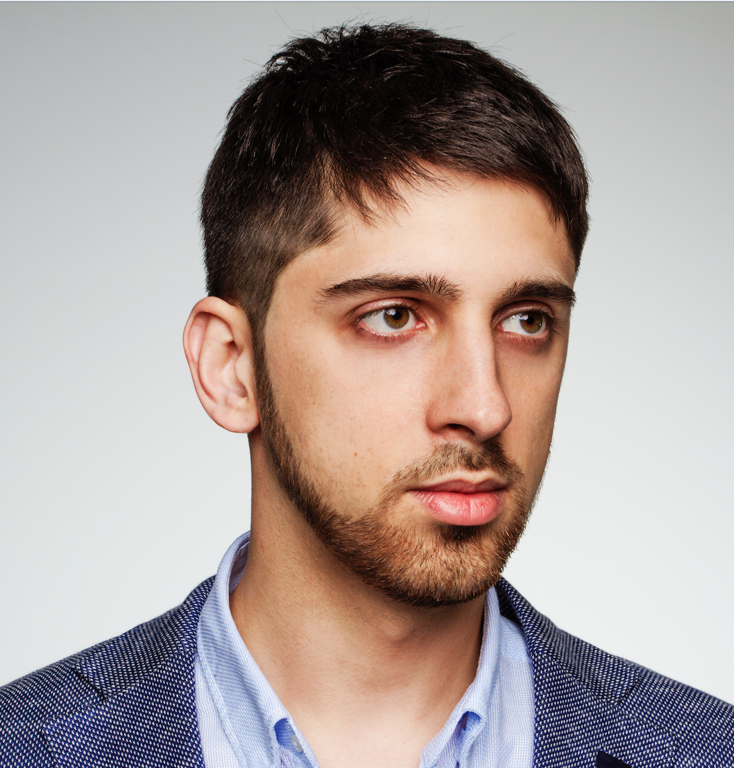
THANKS FOR ATTENTION
oleg.kudrenko@gmail.com
FB: Oleg Kudrenko

