Slide 1
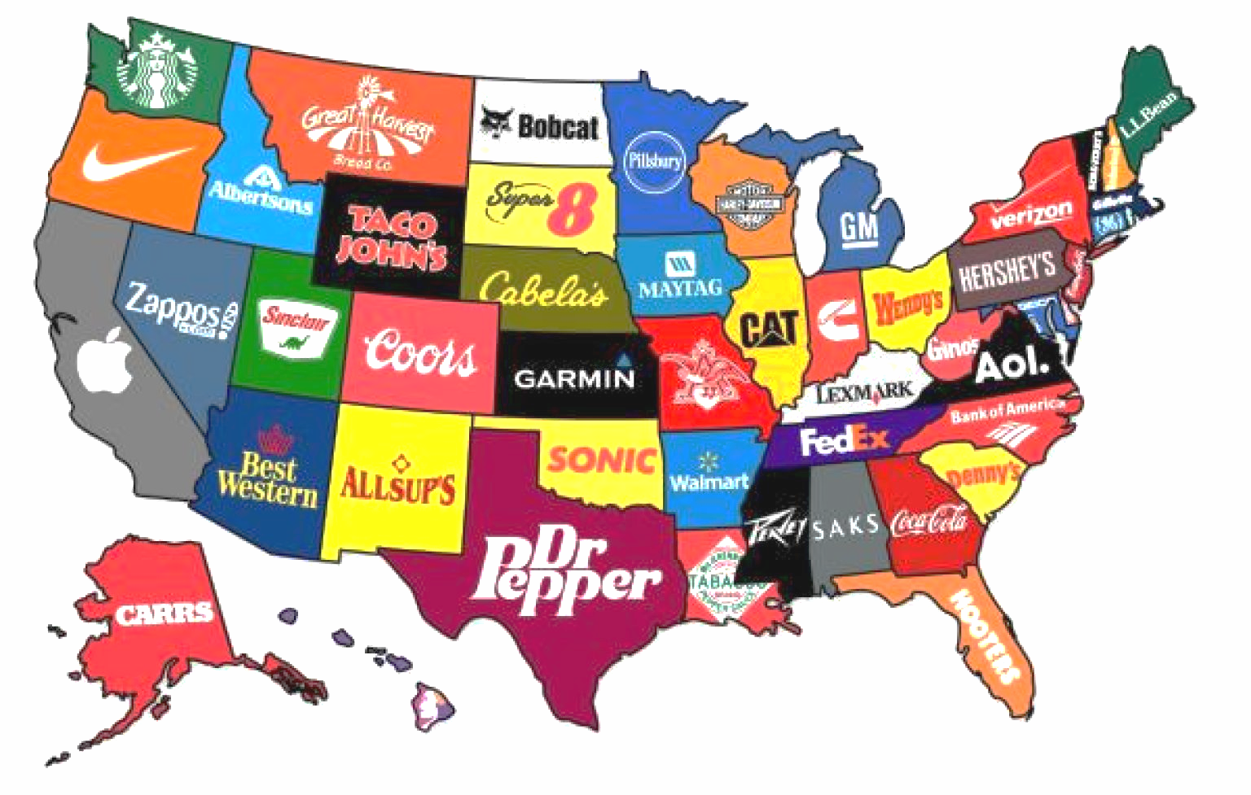
How to Bootstrap in Europe for an American Market
John Uke

Slide 2

Exploration
Research (Google)
Interview people
Surveys
Spec product
Feedback (Startup Crash Test)

Slide 3
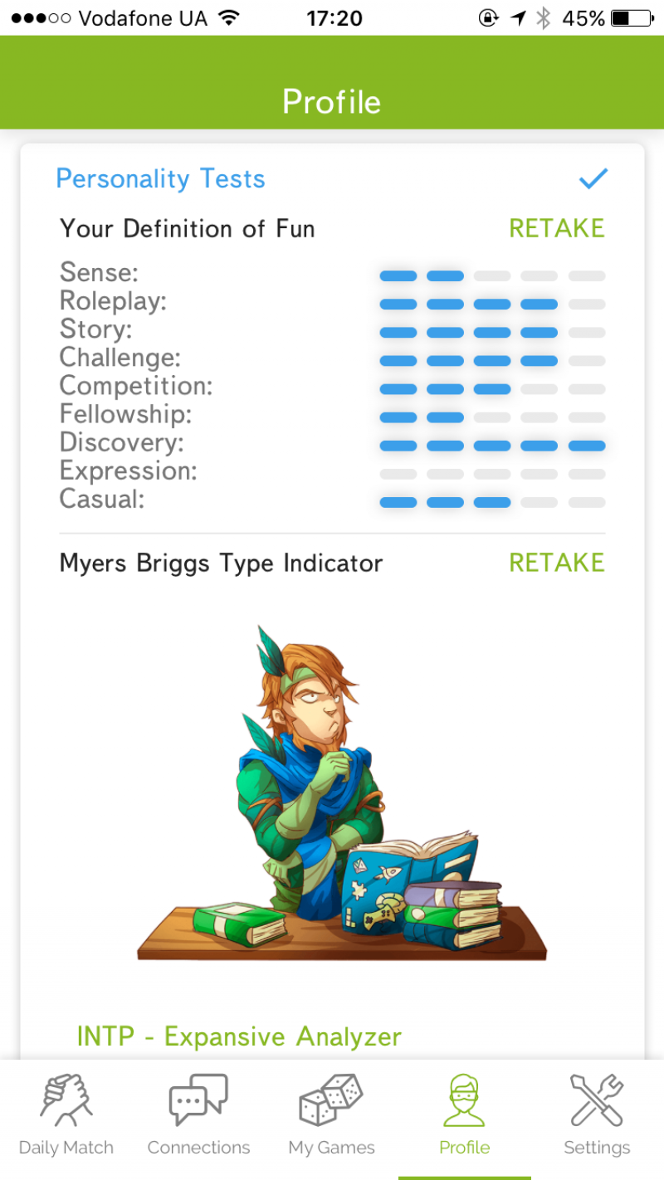
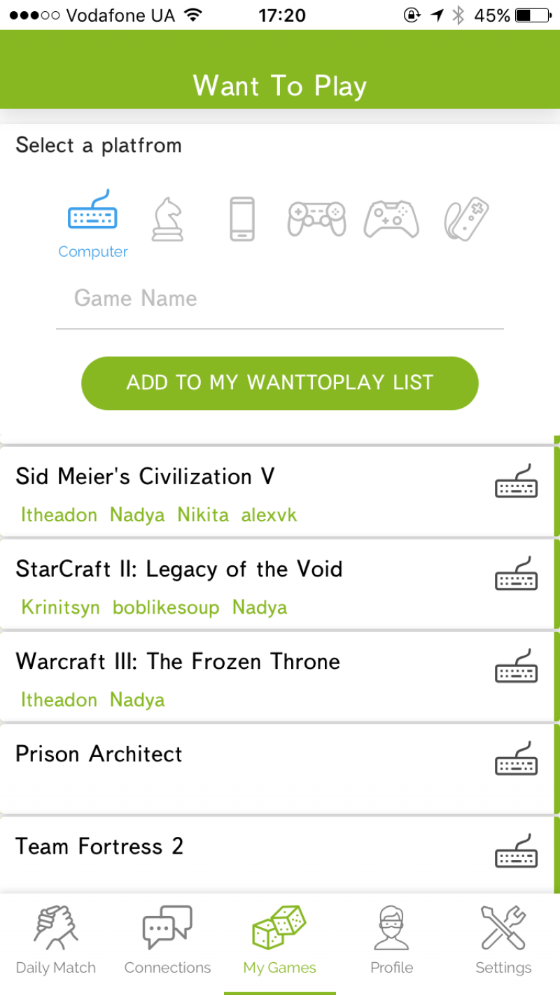
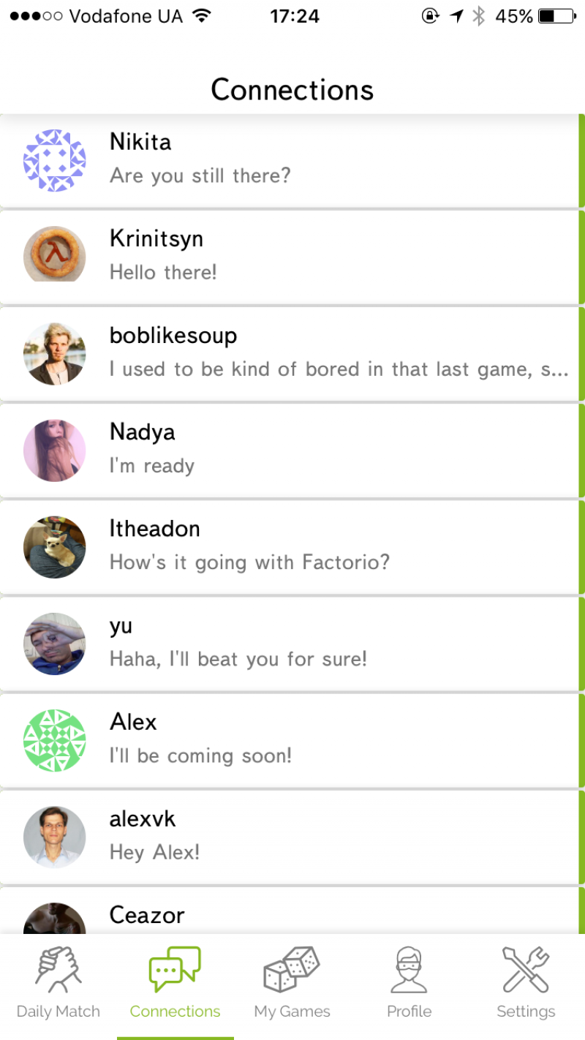
Make designs!!!!!!
Notes:
Drawings then real ones.
Guides thinking. Needed later anyways. Proof-of-concept for feedback.
Free feedback videos: peek.usertesting.com

Slide 4

Finding Talent
Find new designers and get samples
Google + ask around places to post
Spam Upwork + LinkedIn

Slide 5

Recruiting
NOT
Low pay
Long hours
YES
Practice English
Cool market
Interesting project from ground up
Varied tasks
Meaning (product solve need/impact on world)

Slide 6

Legalities
Wait to incorporate, then
Delaware C-Corp
  Most widely used.
  Easy to set up. Don’t need an attorney
    quora.com/How-much-does-it-cost-to-incorporate-in-Delaware/answer/John-Uke

Slide 7

Fundability
Traction (users)
Revenue
Aim For:
Beautiful design
Good onboarding
ACTUALLY solving a problem

Slide 8
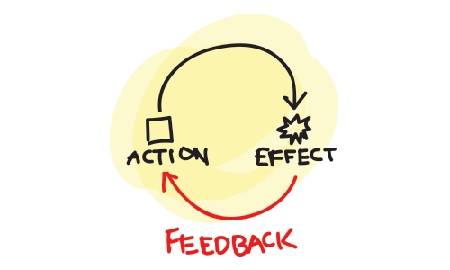
Get + Use Feedback!
Notes:
Guides thinking. Needed later anyways. Proof-of-concept for feedback.

Slide 9

johnuke@gmail.com
www.gametree.me
Recommendations for games and friends

