Slide 1
Business Challenges for Global Company
David Schwartz, May 2017

Slide 2
A little about me and Wix

Slide 3
Founded three start ups- WebMap, PeerApp and Jogli
I head three companies at Wix: eCommerce, Bookings and Promote
VP Product
Notes:
As you listen here today, there are a number of things you should take away
First, that there is a huge need for what we do – web content is becoming more and more popular and there are still an amazing number of businesses that do not have a website of any kind
Second, our technology and product is the best available anywhere to do this – we are not template based, we do not requie coding skills at all. Our software is entirely drag and drop and let’s you create exactly the type of content you want
Third, we have a great business model that drives very strong cohort economics
We have an incredibly talented marketing team that makes decisions based on data and extremely efficient
And Finally, that all of this will enable us to become profitable this year, and we have a clear path to that goal

Slide 4






Power to Create
Online Presence
Documents
Presentation
Blogs
Notes:
And this is why we founded Wix – to provide the power to create
We believe we have the best software and product available to create web content easily and exactly how you want it
This is similar to other software providers that make creating digital content easy – Word, Powerpoint, Tumblr
Each has addressed a need to create content with software, like Wix

Slide 5
Facts About Wix
>100 million
Users
>1.5 million
New Users Each Month
~50%
Subscriptions from free traffic sources
190
Countries with Wix users
50%
of 1,400 employees in R&D, 1000 employees in Israel, Offices in Kyev, Dniepro and Vilnius
0
Sales People
Nasdaq:WIX
As of November 2013 +- $3B

Slide 6
Three Challenges:
Being Far From Your Users
Delivering on Time
Managing Growth

Slide 7
The challenge: we are far, far away from our users

Slide 8

The Challenge- Intimately know your users
50% of our users are in the US
The rest are in 190 countries
Israel is not strategic for us as a potential market- and RTL is an issue
So, how do we know what’s going on there? How are we a user-oriented company?
Notes:
We broke Wix into product units (no, they are not a business units)

Slide 9
Usability Testing: not good enough
Provides questionable results, as it’s a simulation in a safe environment
If you are in Israel and you want it to happen in the US, it won’t happen frequently
Solution: Wix Lounge (ongoing piggy backing)

Slide 10
Support
It’s crucial, and we have written support and phone support (for free users as well).
BUT- product mangers and dev are not exposed to the interactions
Solution:
Developed Wix Answers – a hybrid between a ticketing system and a forum
Now everybody answers
Developed WCC. Now everyone listens
BTW- it’s easier for us to do the tech than to implement the process

Slide 11
Talk to users
Know your users, who they are? their business, their intent
And to NO users
Dropped in the funnel
Relevant business
Users of the competition

Slide 12
And above all…
We are BI and AB Nazis (-;
Three gods
  Conversion
  Churn
  # support calls per user
MVPs

Slide 13
The Challenge: Delivery Oriented Product Management

Slide 14
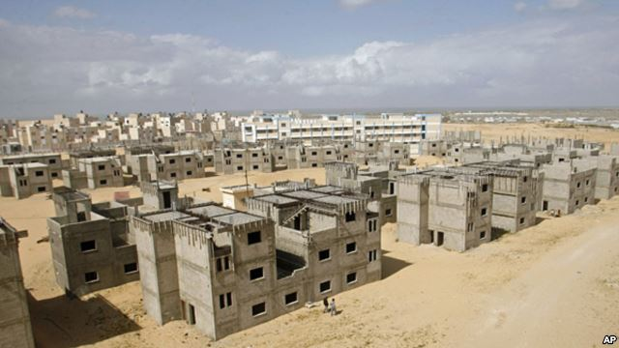
Imagine they never finished 90% of the buildings
About 90% (!!!) of software projects are never finished
Nearly 100% of software projects are never finished in time…

Slide 15
The Software Crisis
About 90% (!!!) of software projects are never finished
Nearly 100% of software projects are never finished on time
Think about that being the case in another engineering field…

Slide 16
The “No Man” Approach to Product
    Why do we need this project?
    Is this project really needed?
    We have this, this, this
    We are simpler, cleaner
    What extra features do you need?
    What features would you take out?
    I am so smart and creative and have amazing ideas
    Great, stop guessing, what do you base this on?
    The core: create an Phase 1 and put it out there!
    Budget / HR / Time / Scope / Quality
    Quality, Budget, HR and Time should be fixed!!

Slide 17
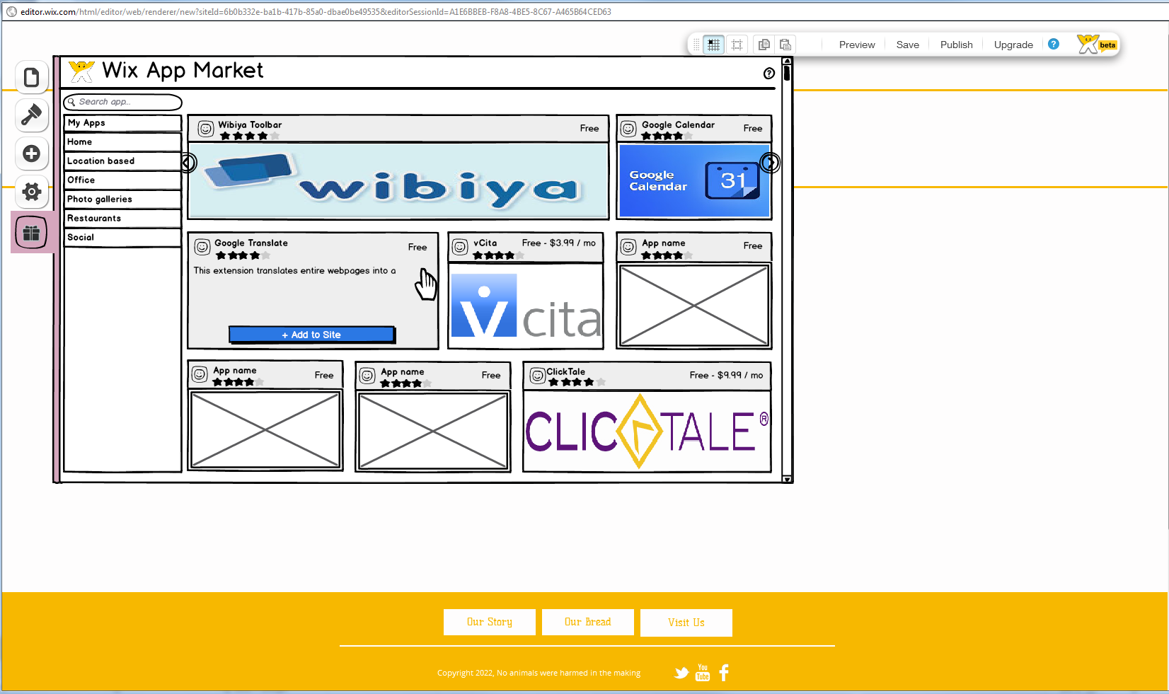
No Specs! Only Wireframes

Slide 18
Wireframes – guidelines
First Phase- the no man approach
  It’s better to have half the features and a product that kicks ass, than double the features and a half ass product!
  More features- longer learning curve
  It’s hard to create; it’s very hard to maintain

Slide 19
Wireframes – guidelines
Sanity check
  If people don’t understand your wireframes they won’t understand your product
  If your wireframes are done in scale you know if you have room for all the things you think you must do (and in German!)
  What is:
    Crucial? Make sure it’s the most noticeable CTA
    Very important? Make it clear, but don’t draw attention from the crucial
    Just important- TAKE OUT OF MVP!
    Nice to have – Uhh?
  Do we really need all this? What can we take out?

Slide 20
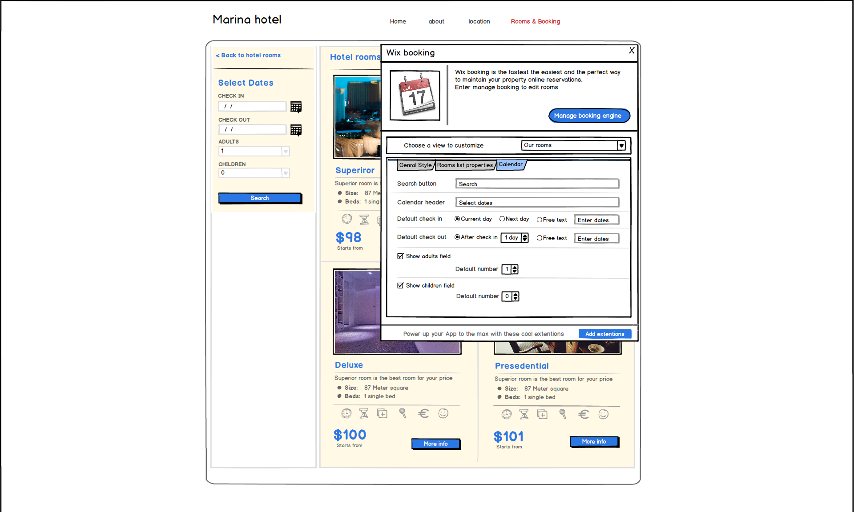
Before

Slide 21
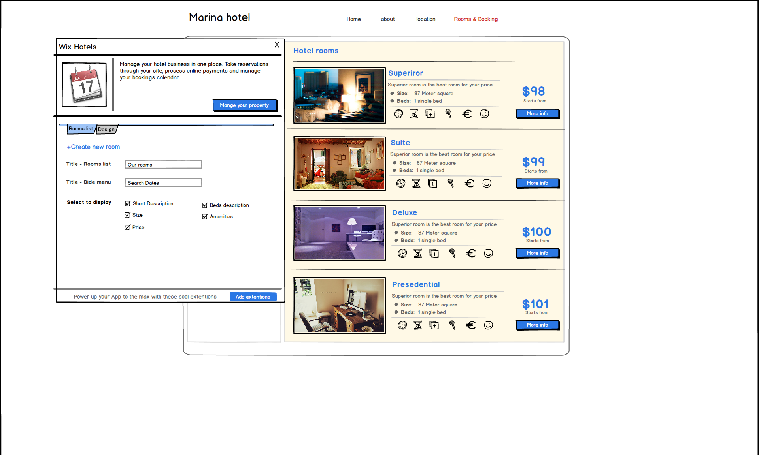
After

Slide 22
Wireframes—Make Decisions
Let the users choose (Android Approach)
  Lots of options- nice
  Overwhelming settings
  You are afraid to decide so you let the users decide
  Every user is different (well – 80/20 rule)
Choose for the users (iPhone approach)
  Make decisions
  Simpler product, less overwhelming
  Less dev, faster launch, easier maintenance
  If life or death- add it in the second phase

Slide 23
The Challenge: Managing Growth

Slide 24
Scaling to a Team of 1,000 (now more than 1500…)
Current
At IPO
At IPO
452
March 2015
Israel
US
Ukraine
Brazil
Lithuania
Russia
Notes:
Pre-IPO – knew we needed to hire aggressively to roll out products
Had to think differently about how to manage the company

Slide 25
Wow! We are more than 100!
  How do we maintain the start-up atmosphere?
  How do we make sure that we’re still efficient and innovative?
  Solution – hire entrepreneurs and let them experiment
  Spin off
  Mid management and management
  Start-ups inside the company (Bingo)
Notes:
Product managed by committees
Moving resources

Slide 26
Wow! We’ll be 1000!
  Big plans, limited resources
  Shorter cycles of product deployment
  Reduce interdependencies
  Recruit and maintain talent
  Preserve company culture
Notes:
Product managed by committees
Moving resources

Slide 27
New Organizational Structure
Companies
Guilds
  Have one product with users that everyone knows and cares about
Horizontal groups that maintain quality across Companies (R&D, BI, etc.)
Notes:
Company –
Has all the needed resources to take the product from A-Z, resources cannot be moved
Autonomy - The company can make its own decision – with minimum dependencies on others
Sit together - All of the company’s employees sit together in one space
Guilds –
professional groups that make sure quality in all fields stays very high
Guilds are the glue between the different companies enabling the overall alignments & knowledge share
Guilds provide the professional guidelines and tool-set to ensure products are meet Wix production quality

Slide 28
Wix Companies
Single product – focus on business and user needs
Best in class – strive for product leadership
Resources – allocated to deliver finished product
Autonomy – minimum dependencies on others (?)
CEO and Chairman can take all decisions (?)
Notes:
We broke Wix into product units (no, they are not a business units)

Slide 29
Wix Guilds
“Glue” enabling alignment and knowledge sharing
Provide guidelines to ensure production quality
Foster professional development
Dedicated to all companies
“Book” of how we do things

Slide 30
Qs and TX!
Facebook / LinkedIn David Schwartz Wix
davids@wix.com
+972 - 54 - 2021621

